Slide 1
Physical Activity and Excess Body Weight and Adiposity for Adults. Consensus Statement for the American College of Sports Medicine
American College of Sports Medicine

Slide 2
Purpose of the Update
This current consensus paper serves as an update and extend prior ACSM position stands (2001, 2009^{)1,2} and consensus paper (2019)³ on the role of physical activity in the prevention of weight gain and obesity.

Slide 3
Background
The American College of Sports Medicine (ACSM) recognizes that the condition of excess body weight and adiposity (EBWA) is complex, with numerous factors warranting consideration.

Slide 4
This expanded and updated report includes:
Contemporary perspectives on defining excess body weight and adiposity (EBWA)
Medical management of body weight regulation
The influence of physical activity (PA) on energy balance regulation and food intake
PA mode and volume considerations
application to various population groups
strategies for PA engagement within the context of body weight (BW) regulation
Research areas for consideration, with a focus on PA and considerations for exercise and fitness professionals
Introduction

Slide 5
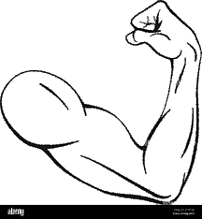
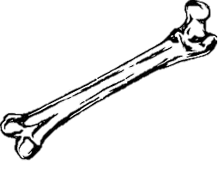
Definitions and Clinical Considerations
EBWA, typically termed overweight or obesity, is a chronic health condition that warrants appropriate and effective treatments, and this persists across the lifespan ^{4, 5-7}
Treatment should:
be conducted within the context of overall health and the concurrent presence of other health conditions
occur within the context of shared decision making that consider the perspectives of the provider, other members of a comprehensive care team, and the individual
Adults with EBWA should consider the following:
reduce BW by a minimum of 5–10% ⁸
maintain at least this magnitude of weight loss long-term⁸
weight loss of greater magnitude, with an effort on sustaining weight loss, may have additional health benefits that may include reducing the onset of chronic conditions such as cardiovascular disease.^{8,9}
for some individuals, there may be health benefits with weight loss of less than 5%
the health benefits of varying amounts of weight loss should be monitored by clinicians

Slide 6
Recognition of Public Health Considerations
Prevention and treatment strategies for EBWA should adopt
a broader systems approach as proposed by the National Academies of Science, Engineering, and Medicine’s Roundtable on Obesity Solutions that includes the leverage points of structural racism and social justice, biased mental models and social norms, and effective health communications¹⁰
Treatment for individuals with EBWA should be provided
using “People-first” language (i.e., “individuals with obesity” rather than “obese individuals”)
public policies that facilitate healthful eating behaviors and engagement in adequate PA and promote prevention and management of EBWA
in an unbiased manner, with all individuals given equitable access to effective and affordable treatment options

Slide 7
Definitions and Clinical Considerations
Body mass index (BMI) computed from body weight and height (kg/m²) has been widely accepted to define overweight and obesity
ACSM supports the use of BMI as an initial screening tool for the potential presence of excess body weight or potential excess adiposity
Physicians and health care professionals should BMI within the context of broader health considerations when contemplating treatment options
BMI may misclassify an individual with overweight or obesity when there is a high amount of lean mass or when other health consequences are not observed with the presence of elevated BMI
Further evaluation of body composition may be warranted, which may include measures of total and regional adiposity and subcomponents of lean mass, bone, muscle, specific organs (e.g. heart, liver)

Slide 8
Consensus Statement on Medical Treatment Considerations
ACSM supports the inclusion of PA, as deemed to be medically appropriate, within each medical approach to manage EBWA
Anti-obesity medications (AOMs) and metabolic/bariatric surgery are effective treatments for EBWA, and for the treatment of adiposity-related health conditions
AOMs should be used in combination with a behavioral intervention that focuses on eating and PA behaviors that are consistent with individual needs and complement the effectiveness of the AOMs ⁴
Include both aerobic and resistance modes of PA with AOM’s and metabolic/bariatric surgery

Slide 9
Consensus Statement on Medical Treatment Considerations
The inclusion of PA for individuals undergoing treatment with AOMs or metabolic/bariatric surgery should:
-extend beyond its effects on BW
-be considered within the context of holistic health and well-being
-may also need to include balance training to enhance kinesthetic awareness
The initiation and progression of PA should consider an individual’s capacity and physical abilities and warrants appropriate medical clearance by the patient’s medical care team
The comprehensive treatment team should include a professional with the appropriate training and certifications, such as an ACSM Certified Clinical Exercise Physiologist, to apply PA to the treatment of individuals receiving treatment with an AOM or metabolic/bariatric surgery

Slide 10
Consensus Statement on PA Treatment Considerations
10
PA contributes to the prevention of EBWA , and an increase in PA above current levels results in weight loss and reduced adiposity, in a dose-response manner.
The effects may be most prevalent when PA is progressed in an appropriate manner to at least 150 min/wk of moderate-intensity PA, or the equivalent dose if at a different intensity.
The effects of PA are additive to the effects of reduced energy intake for effects on EBWA.
Total energy expenditure resulting from moderate-to-vigorous PA, regardless of bout duration, is associated with lower body weight and possibly adiposity. However, whether accumulating PA in bouts less than 10 minutes in duration is as effective for change in EBWA compared to bouts of activity performed in longer bouts, which are of equal energy expenditure, is unclear.
Engaging in PA in a consistent pattern across days contributes to sustained engagement. However, data are limited and not consistent regarding whether the time of day one engages in PA will have differential effects on body weight and adiposity.

Slide 11
Consensus Statement on PA Intensity Considerations
Evidence does not support that any one single mode of PA is superior to other modes for the prevention of weight gain or weight loss, provided that the dose of PA is sufficient to result in the necessary effects on energy expenditure and energy balance.
To elicit holistic health benefits beyond the effects on BW and adiposity, multi-modal physical activity, rather than a single mode of PA, should be recommended for persons with EBWA that include:
1) aerobic activity
2) resistance forms of activity
3) mind-body forms of PA
4) balance training

Slide 12
Consensus Statement on Dietary Considerations
Dietary approaches that
- lead to a reduction in energy intake will be the most effective for treating EBWA
- reduce portion size can assist in the prevention of weight gain and may contribute to reducing energy intake resulting in weight loss
Time restricted eating and intermittent fasting do not appear to be superior to low-energy intake diets
At the population level, one type of diet and macronutrient composition does not appear to be more effective for weight loss when compared to other approaches, provided that these approaches result in similar negative energy balance

Slide 13
Consensus Statement on PA and Regulation of Energy Intake and Eating Behavior Considerations
A single bout of aerobic exercise does not increase hunger or energy intake over the subsequent 24 hours, yet further evidence is needed to examine individual responses. When performed over the longer-term, regular aerobic exercise can elicit partial compensation in energy intake.
High habitual levels of PA may sensitize the control of appetite with a tighter coupling between energy expenditure and energy intake following energy perturbations, whilst physical inactivity and sedentariness fail to downregulate energy intake and can permit overconsumption.
The complex interaction between energy expenditure and energy intake means that the effects of exercise on the control of appetite will be variable between individuals.

Slide 14
Consensus Statement on Population and Individual Specific Considerations
Providers and comprehensive care teams must acknowledge that social determinants of health influence EBWA and an individual’s access to PA.
For persons with physical disabilities, mobility limitations, or intellectual and developmental disabilities, PA should involve adaptive PA and sport programs that are developmentally appropriate and are tailored to address the needs of individual persons and that are effective for BW regulation, treatment of EBWA, and treatment of adiposity-related health conditions.
PA is an important lifestyle behavior across the lifespan and PA approaches that are age and developmentally appropriate should be implemented to effectively contribute to BW regulation.
Implement PA approaches that are inclusive of sex, self-identified gender, race, ethnicity, and socio-economic status. This includes addressing systemic and structural factors such as providing access to safe and inclusive environments for physical activity, affordable opportunities to be inclusive of socio-economic status, and access to opportunities that are inclusive of individual PA preferences.

Slide 15
Consensus Statement on Strategies for Supporting PA Considerations
Encourage the use of self-monitoring techniques that are appealing to users and that provide relevant feedback to promote PA, including wearable devices.
Promote the different forms, channels, and methods for ongoing support of PA. This can be through:
online communities
personal networks
community-based partnerships
outlets that are safe, diverse, and inclusive
Since affective experiences may constitute an important barrier to PA participation, strategies to preemptively address possible contributing factors that include reconsidering the physical and social environment.

Slide 16
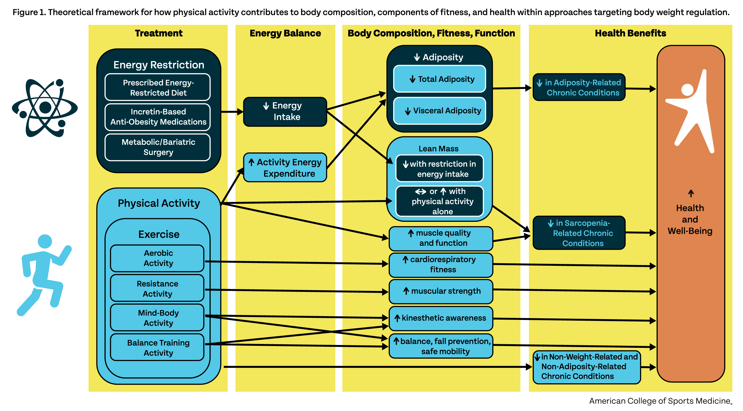

Slide 17
Summary
These consensus statements update prior ACSM position statements ^{(1,2)} and consensus paper ⁽³⁾ considerations on the importance of PA within the context of body weight and body composition regulation with new perspectives on pertinent clinical and public health considerations and the need for research.
Within this context, ACSM advocates for PA to be a key element of prevention and treatment efforts for EBWA with a focus on
Inclusive approaches to facilitate adoption and sustained engagement of PA of all persons
Providing access to environments, facilities, equipment and evidence-based programs in support of PA in an equitable manner for all persons and should consider PA benefits as a covered benefit by employers and other health care payers
Support for inclusion of appropriately trained and certified exercise professionals within clinical, public health and heath fitness teams targeting EBWA prevention and treatment
Approaches to be considered within the context of holistic health and well-being, and involve shared decision-making between the patient and healthcare provider

Slide 18
References
1. Donnelly JE, Blair SN, Jakicic JM, Manore MM, Rankin JW, Smith BK. ACSM position stand on appropriate intervention strategies for weight loss and prevention of weight regain for adults. Med Sci Sports Exerc. 2009;42(2):459-71.
2. Jakicic JM, Clark K, Coleman E, Donnelly JE, Foreyt J, Melanson E, et al. American College of Sports Medicine Position Stand: Appropriate Intervention Strategies for Weight Loss and Prevention of Weight Regain for Adults. Med Sci Sports Exerc. 2001;33(12):2145-56.
3. Jakicic JM, Powell KE, Campbell WW, DiPietro L, Pate RR, Pesctello LS, et al. Physical activity and the prevention of weight gain in adults: A systematic review. Med Sci Sports Exerc. 2019;51(6):1262-9.
4. World health statistics 2023: monitoring health for the SDGs, Sustainable Development Goals. Geneva: World Health Organization, 2023.
5. Bray GA, Heisel WE, Afshin A, Jensen MD, Dietz WH, Long M, et al. The science of obesity management: an Endocrine Society scientific statement. Endocrine reviews. 2018;39:1-54.
6. Hampl SE, Hassink SG, Skinner AC, Armstrong SC, Barlow SE, Bolling CF, et al. Executive Summary: Clinical Practice Guideline for the Evaluation and Treatment of Children and Adolescents With Obesity. Pediatrics. 2023;151(2). doi: 10.1542/peds.2022-060641. PubMed PMID: 36622135.
7. Jensen MD, Ryan DH, Apovian CM, Ard JD, Comuzzie AG, Donato KA, et al. 2013 AHA/ACC/TOS guideline for the management of overweight and obesity in adults: a report of the American College of Cardiology/American Heart Association Task Force on Practice Guidelines and The Obesity Society. J Am Coll Cardiol. 2014;63:2985-3023.

Slide 19
References (continued)
8. Jensen MD, Ryan DH, Apovian CM, Ard JD, Comuzzie AG, Donato KA, et al. 2013 AHA/ACC/TOS guideline for the management of overweight and obesity in adults: a report of the American College of Cardiology/American Heart Association Task Force on Practice Guidelines and The Obesity Society. J Am Coll Cardiol. 2014;63:2985-3023.
9. Gregg EW, Jakicic JM, Blackburn G, Bloomquist P, Bray GA, Clark JM, et al. Association of the magnitude of weight loss and changes in physical fitness with long-term cardiovascular disease outcomes in overweight or obese people with type 2 diabetes: a post-hoc analysis of the Look AHEAD randomised clinical trial. The lancet Diabetes & endocrinology. 2016;4(11):913-21. Epub 20160830. doi: 10.1016/s2213-8587(16)30162-0. PubMed PMID: 27595918; PubMed Central PMCID: PMC5094846.
10. Pronk NP, Eneli I, Economos CD, Bradley D, Fassbender J, Calancie L, et al. Using Systems Science for Strategic Planning of Obesity Prevention and Treatment: The Roundtable on Obesity Solutions Experience. Curr Probl Cardiol. 2023;48(8):101

Slide 20
Acknowledgements
This slide deck was prepared by the ACSM Evidence-Based Practice Committee in collaboration with the authors.
Peter T. Katzmarzyk, Ph.D., FACSM
James Patrick MacDonald, M.D., M.P.H. FACSM
Christan E. Behrens, Jr., PhD
Hayley V. MacDonald, Ph.D.
Christina Anne Day
Dawn Podulka Coe, Ph.D., FACSM
Mary P. Miles, Ph.D., FACSM
Terry L. Nicola, M.D., FACSM
Bridget A. Peters, DO, PhD
Adrienne Wald, EdD
Melicia C. Whitt-Glover, Ph.D., FACSM
John Willson
Laura Young, PhD

