Slide 1
Live Q+A Start
Times
Northland Chapter
2021 Virtual Conference
11:00 = Stephen Seiler, PhD; University of Agder, Norway
  “From Polarized to Individually Optimized Endurance Training...in 5 steps"
12:00 = Chelsea Stillman, PhD; University of Pittsburgh
  “The Impact of Exercise and Other Modifiable Lifestyle Behaviors on Human Brain Structure & Function"
1:00 = Kevin Luhrs, MS, RD, CSCS; Gatorade Sports Science Institute
  “Ergogenic Aids Backed by Science”
2:00 = Kyle Hackney, PhD; North Dakota State University
  "Blood Flow Restricted Exercise Mechanisms and Adaptations: Where do we go from here?"
3:00 = Renee Rogers, PhD; University of Pittsburgh
  "Bridging the Gap between Tech and Media and Outcomes and Engagement"

Slide 2



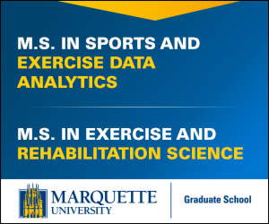


Thank you to our Sponsors!
Northland Chapter 2021 Virtual Conference

