Slide 1


American College of Sports Medicine
Testing in Intermittent Sports - Importance for Training and Performance Optimization in Adult Athletes.
Consensus Statement for the American College of Sports Medicine.

Slide 2
2
To provide an overview of available tests in different exercise domains identified as relevant forming the basis for recommendations on how to compose a comprehensive yet feasible test battery that may be integrated in the seasonal competition and training plan.
To identify a framework for testing procedures that cover the performance spectrum of relevance for the individual athlete, including positional differences in team-sports.
To highlight the benefits of sport-specific tests and parameters of importance for test standardization.
Where applicable, detail how testing batteries may be supplemented with secondary tests directed toward specific energy systems.
Purpose of the Consensus Statement

Slide 3
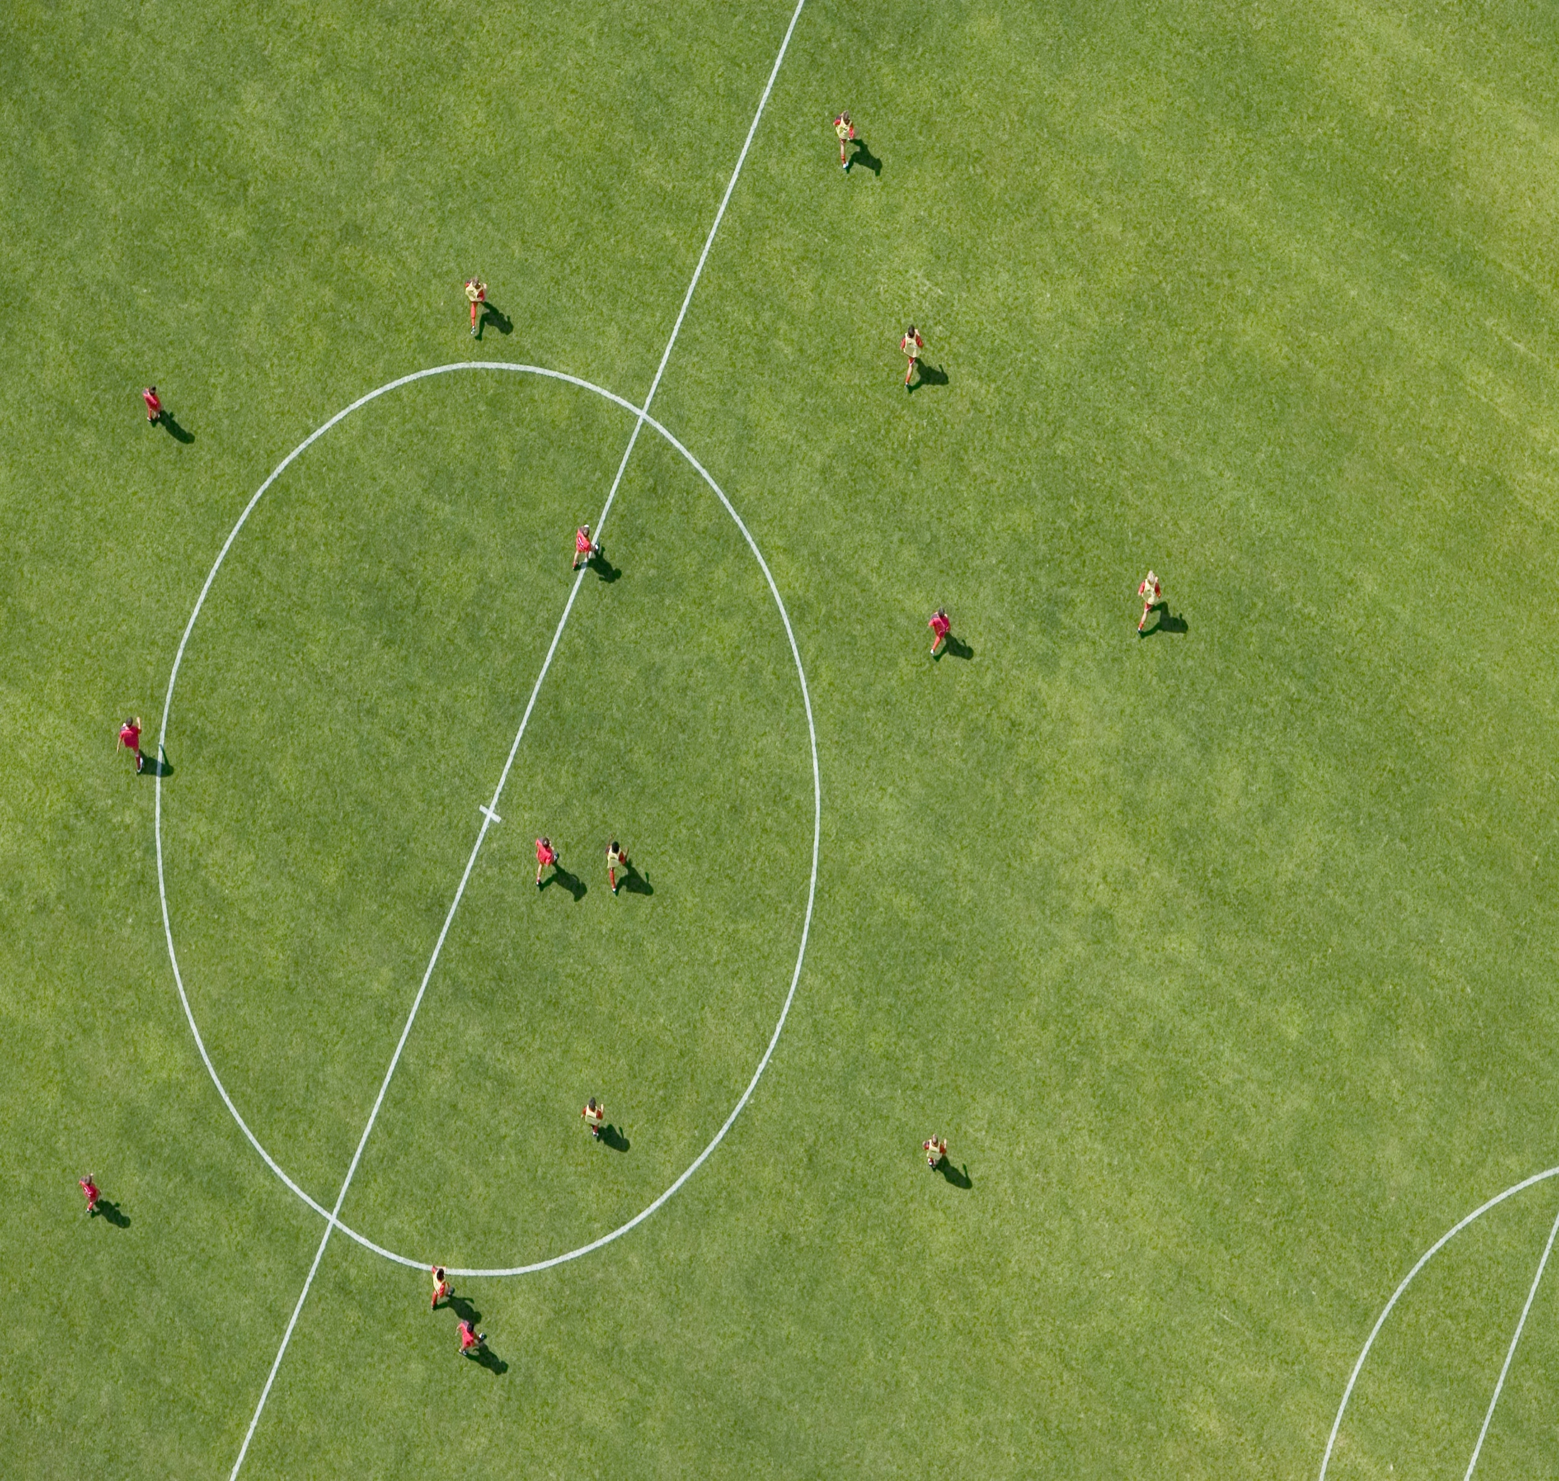

Introduction
3
Definition: Intermittent sports involve frequent changes in activity intensity, alternating between high-intensity efforts and periods of low intensity or rest ¹⁻⁶.
Examples: soccer, basketball, and ice hockey
  demanding rapid acceleration, deceleration, and frequent changes of direction.
Performance Factors: Success in these sports relies on a combination of explosive power, cardiovascular fitness, endurance, agility, and the ability to resist fatigue ¹¹⁻¹⁴.
Objective: This presentation examines the physiological demands of intermittent sports and the role of fitness testing in optimizing athlete performance.

Slide 4

Physiological Demands
Multi-faceted Demands: Requires a combination of aerobic (endurance) and anaerobic (short bursts) energy systems.
High-Intensity Efforts: Involves sprints, jumps, and rapid direction changes, demanding high neuromuscular power.
Endurance: Durability and repeatability is essential for maintaining performance over extended periods and aiding recovery between high-intensity bouts.
Strength and Agility: Crucial for power generation and efficient movement.
Recovery Efficiency: Quick recovery during low-intensity phases is critical for sustaining overall performance.

Slide 5
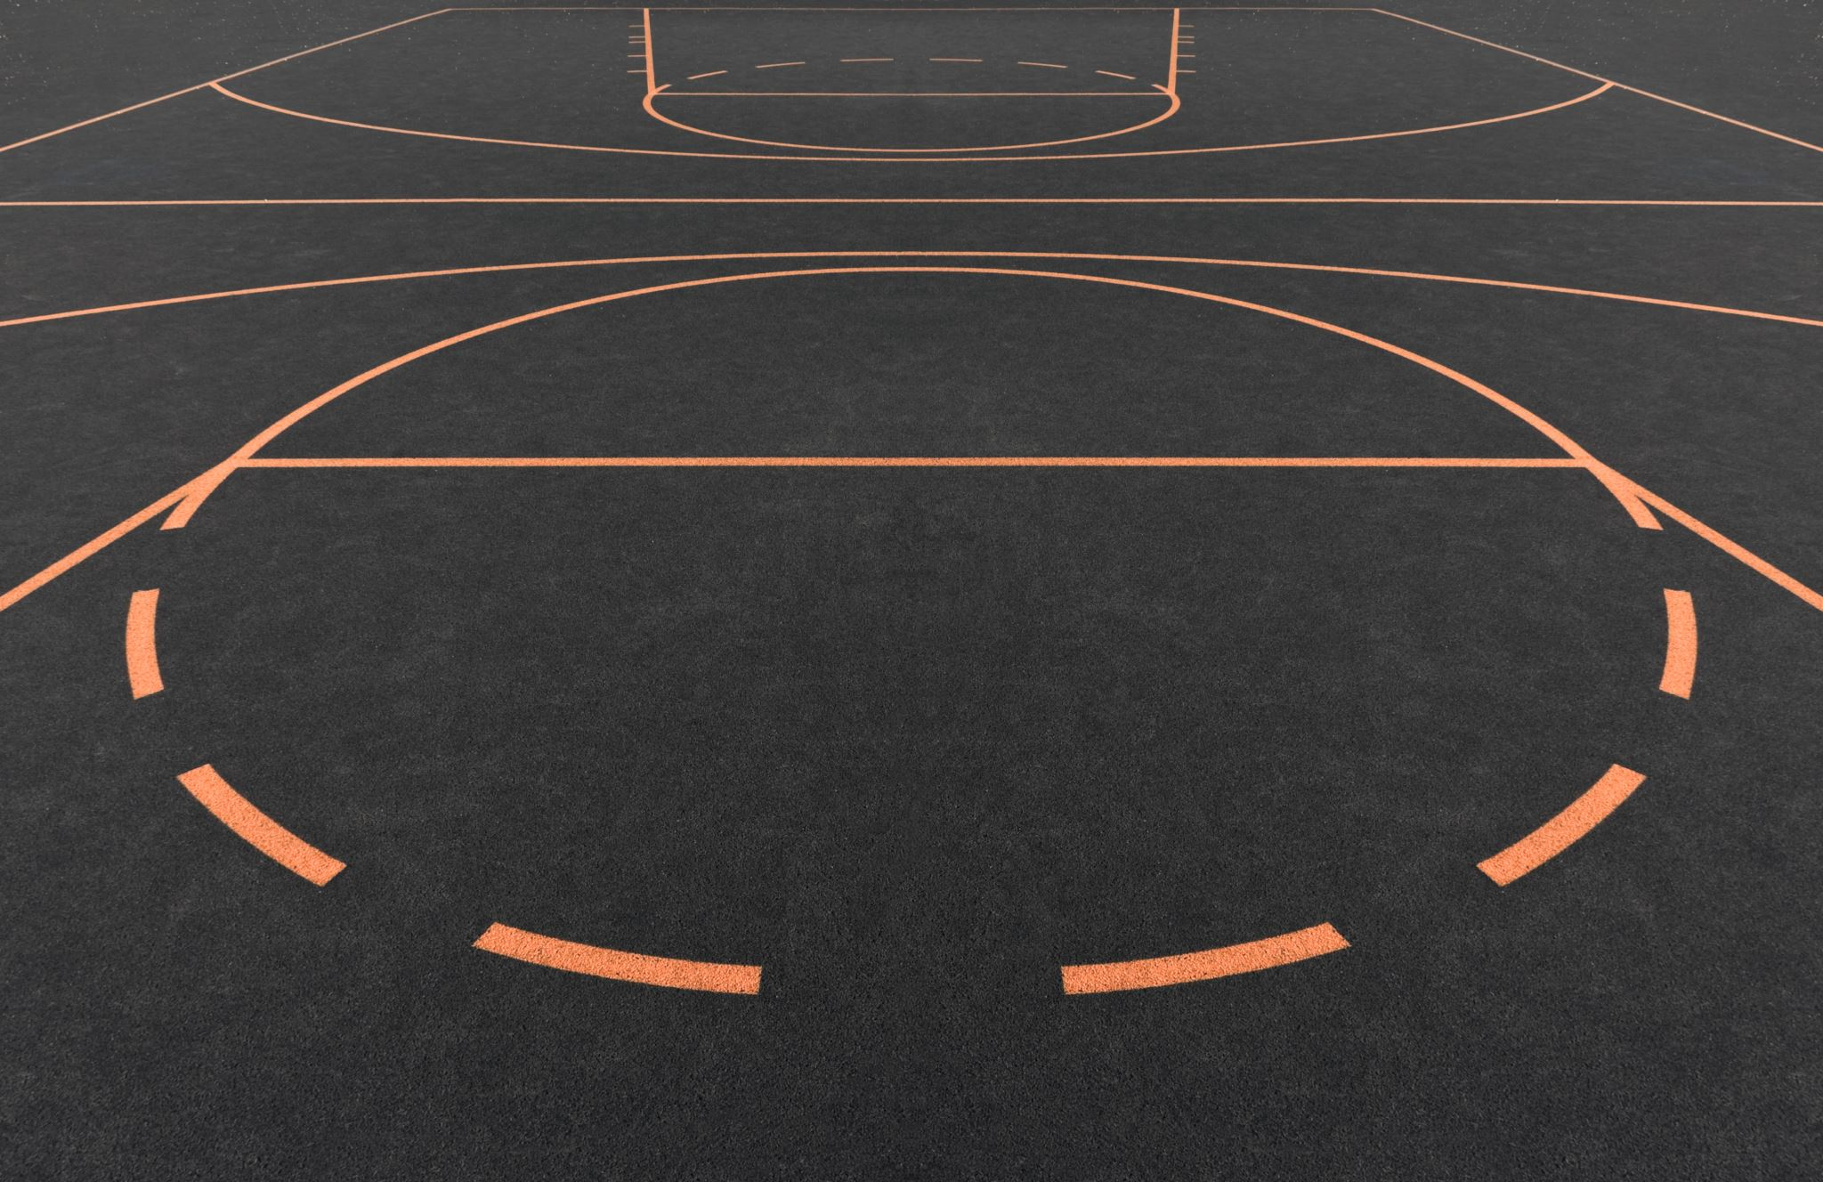
5
Energy System Interactions
Anaerobic System:
  Role: Powers short, high-intensity efforts.
  Examples: Sprints, jumps, quick direction changes.
  Characteristics: Relies on phosphocreatine and stored muscle glycogen, producing energy without oxygen.
Aerobic System:
  Role: Supports intermittent and prolonged activity and aids recovery.
  Examples: Repeated sprint activities, continuous running and jogging during low-intensity phases.
  Characteristics: Uses oxygen to produce energy, supporting endurance and recovery.
Interaction: Successful performance hinges on the efficient interaction between these systems, allowing for sustained high-intensity efforts and effective recovery.
^{9, 101-105, 107-115, 125}

Slide 6
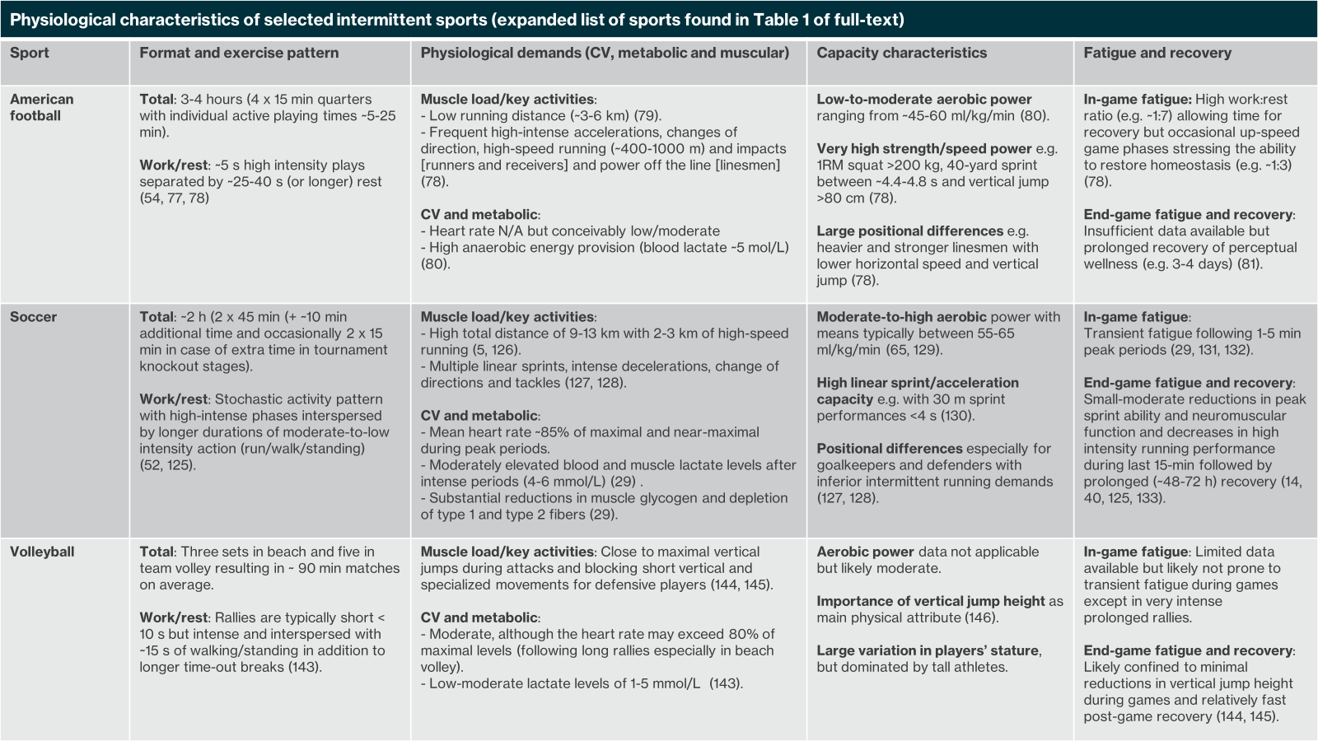

Slide 7
Physiological characteristics of selected intermittent sports (expanded list of sports found in Table 1 of manuscript)
Sport | Format and exercise pattern | Physiological demands (CV, metabolic and muscular) | Capacity characteristics | Fatigue and recovery
Basketball | Total: ~2-2.5 hours (4 x 12 min active playing time with individual times of ~30-35 min). Work/rest: Brief intense bursts of accelerations, directional changes, shuffling movements and jumping separated by longer duration low-to moderate intensity activities (12). | Muscle load/key activities: - Moderate running distance (~5-7 km) (2). - Maximal jumps (e.g. ~1 per min) and short high-intensity shuffling/acceleration/change of direction movements (2). CV and metabolic: - Mean heart rate 80-90% of maximum (2). - Substantial anaerobic energy system contribution to intense efforts (blood lactate ~5 mmol/L) (2, 95). | Low-to-moderate aerobic power ranging widely between ~45-60 ml/kg/min (12, 96). Very high vertical jump and well-developed short sprint/change of direction abilities e.g. ~80 cm vertical jump and 20-m sprints of ~2.43-3.24 s (12). Positional differences with centers in particular taller, heavier, slightly slower and with lower aerobic power than guards and forwards (12). | In-game fatigue: Limited data available but conceivably transient fatigue following intense efforts. End-game fatigue and recovery: Reduced activity profiles during last quarter and small reductions in neuromuscular function, with insufficient data on recovery available (97-100)
Boxing | Total: ~11 min (3 x 3 min rounds at Olympics). Work/rest: Sustained intermittent work with intense punching and defensive actions interspersed by short clinging between opponents during rounds and 1-min rest periods between rounds (101-104). | Muscle load/key activities: - High-force transmission during punches (e.g. ~20 per min) involving mainly the upper body and secondarily the legs (101). CV and metabolic: - Mean of >85-90% of maximal heart rate during rounds - Moderate to very high blood lactate levels (5-15 mmol/L) (101, 104, 105). | Moderate-to-high aerobic power with reported values of 50-65 ml/kg/min (101, 103). Very high strength/power outputs with isometric strength and punching force related to competitive level and with importance of both upper and lower limb explosiveness (103, 105). | In-game fatigue: Insufficient data available but likely considerable transient fatigue following intense actions/rounds. End-game fatigue and recovery: Little or no reductions in lower or upper body power output from pre to post game entailing fast recovery after single games (105).
Tennis | Total: Typically best of five sets yielding 2- 4 h and in extremes >5 h matches. Work/rest: Average points <10 s of intermittent high intense acceleration or deceleration and hitting actions interspersed with ~15-30 s passive recovery (53, 138). | Muscle load/key activities: High during maximal accelerations and deceleration efforts (53). CV and metabolic: - Mean heart rate 60-80% of maximum (53, 139). - High taxation of anaerobic energy systems during brief intense rallies (blood lactate 3-6 mmol/L) (53, 139). -Glycogen depletion not well described but may be significant during long matches. | Moderate-to-high aerobic power with mean values ranging between 55-65 ml/kg/min (53). High agility and explosive performance and resistance to fatigue during repeated brief high intense rallies (53). Potential differences between playing styles/approaches. | In-game fatigue: Fatigue within prolonged rallies conceivable but rest and pacing opportunities amidst plays likely enabling recovery. End-game fatigue and recovery: Reductions in neuromuscular function, running and hitting speed post-game with indications of accumulating fatigue during consecutive days of playing.(140-142).

Slide 8

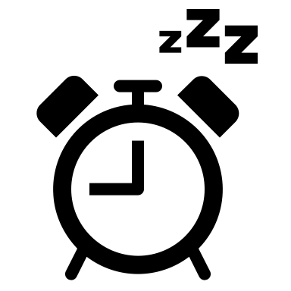
Fatigue and Durability
Types of Fatigue:
In-Game Fatigue: Occurring after intense periods, fully or partially recoverable after lower intense or rest periods.
End-Game Fatigue: Accumulative fatigue over the time-course of a match and affecting performance towards the end of the game, requiring longer recovery/restitution periods.9,11,50,67,78,80,85,116-124,126,127
Durability Factors: Athletes need a high level of both energy system efficiency and muscular endurance to withstand prolonged intermittent activity.
Recovery Strategies: Effective recovery techniques (e.g., hydration, nutrition, rest) are essential to manage fatigue and maintain performance.

Slide 9

The Role of Formal
Fitness Testing
9
Purpose: Provides standardized, quantifiable data on athletes’ physical capacities.
Complimentary Tools: Works alongside athlete tracking technologies and match performance analysis.
Applications:
Talent Identification: Helps in spotting potential athletes and top performers.
Training Evaluation: Measures the effectiveness of training programs and identifies areas needing improvement.
Injury Recovery: Monitors progress and readiness for return to play, ensuring safe and effective rehabilitation.
Benefits: Informs training adjustments, helps optimize performance, and aids in the development of personalized training plans. ¹⁵⁹⁻¹⁶²

Slide 10
Test Categories
Overview
Strength, speed and power tests
Overall “test-category” | Generic examples and typical tests | Relevance for intermittent sports
“Single Exercise” strength testing | -Strength testing covers variety of sub-categories, including lower-body/upper-body/core, single joint/multi-joint, concentric/isometric/eccentric, isoinertial/isokinetic strength (227). -One-repetition maximum (1RM) and isometric strength (with or without RFD [rate of force development]) are the most frequent scoring methodologies. Can be applied for most exercises e.g. squat, lunges, hip thrust for lower-body or relevant upper body. | -Realization of true maximal strength is quite infrequent in intermittent sports and direct associative or predictive value lower than e.g. power or “functional” test measures in terms of benchmarking or prediction of match/athletic performance (226). -However, strength testing may be useful and conducted to identify individual training needs, for tracking training progression, and/or injury risk assessment.
Jump testing and vertical power assessment | -Jumps with/without stretch-shortening cycle, bilateral/unilateral jumps, unloaded/loaded jumps and vertical/horizontal jumps (255). -Jump height, concentric mean/peak power and the reactive strength index most frequently adopted scoring systems (256-258). -Force-velocity profiles can in practice be conducted for almost all (strength) exercises, but of main relevance and value for vertical power (and jumping) (242). | -While vertical jumps may be highly relevant in some sports, they often constitute a very limited fraction of the overall game play. -However, jump testing is typically encompassed due to its simplicity and provision of information regarding overall lower-extremity explosiveness. -Vertical (SJ) power evaluation appears to provide additional information of relevance both for vertical and horizontal movements (179, 180).
Unidirectional sprinting and horizontal power assessment | -Linear sprint testing can be conducted over various distances with multiple sampling points typically used, e.g. 5-10 m to quantify acceleration capacity and 30-40 m to assess high velocity sprinting ability (130). -Simple sprint times are the most frequent scoring method, however, calculation of sprint momentum and various split time ratios are also common (259). -Horizontal force-velocity power profile (comparable to the vertical) also applicable – with the sprint version consisting of unloaded sprinting from null to maximal velocity (187). | -Linear sprinting, especially over short and medium distances, is frequently observed in many intermittent sporting such as all types of football/soccer, handball and basketball, where it is often involved in match-deciding sequences (9).
Change of direction (COD), “agility” and sport specific “speed tests” | -Change of direction ability and agility tests are similar except for the inclusion of an element of uncertainty during agility testing, i.e. unknown movement pattern (212). -Common change of direction tests include Illinois, L-Run, Pro-Agility, T-test, 505, the Arrowhead test or Lane test with reaction-based agility tests typically adopting a Y- or a T-shape change in direction (209, 213). -Simple performance time is most frequently used. However, in combination with sprint testing, the so-called change of direction deficit is often computed as a supplementary measure (259). | -Both change of direction and agility components Inherent ability in several intermittent sports, with some arguing for a greater ecological validity of reaction-based agility tests due to the adoption of unplanned rather than planned change of direction tasks (212).
Deceleration tests | Recently emerging in intermittent sports with tests applying either a maximal deceleration after crossing a certain point (e.g. 10, 15 or 20 m mark) or decelerating maximally and stopping on a pre-defined spot. Can be measured using either video-systems, radar technology or simple deceleration distance. | Relevant in many intermittent sports with a large number and intensity of deceleration efforts (8).
10
General Fitness Tests:
Environment: Conducted in controlled settings, often laboratories.
Purpose: Assess fundamental physical attributes applicable across various sports.
Examples: VO2max tests, strength assessments. ^{74, 169-171}
Sport-Specific Tests:
Environment: Designed to replicate real-game conditions and specific demands of the sport.
Purpose: Provide targeted insights into an athlete’s performance in sport-specific scenarios.
Examples: Repeated sprint tests, intermittent endurance tests^{. 164,165,172}
Importance: Each category offers unique insights, contributing to a comprehensive understanding of an athlete’s fitness profile.

Slide 11

General Fitness Tests
11
VO_{2max} Test
Measures: Maximal oxygen uptake, indicating aerobic capacity.
Importance: Higher VO_{2max} values correlate with better endurance performance.
Strength Assessments
Measures: Squats bench presses isometric contractions
Importance: Evaluates muscle strength and power, crucial for explosive movements and injury prevention.
Flexibility and Mobility Tests:
Measures: Range of motion and joint flexibility
Importance: Essential for optimal movement efficiency and injury prevention.
Comprehensive Data: Provides foundational data on overall fitness levels, guiding training focus areas.

Slide 12
Tests with main relevance for the repeatability of maximal actions
Sub-categories | Generic examples and typical tests | Main physiological systems challenged | Relevance for intermittent sports
Continuous all-out effort tests | Maximal accumulated oxygen deficit test (271). 30-s anaerobic Wingate test (269). Maximal lactate accumulation (358). The Bosco jump test (359). Full court shuttle run test (360). W’ derived from critical power tests (170). Anaerobic speed reserve (289). | Anaerobic test with a substantial aerobic component during the latter stages and stressing the ability to endure a degree of metabolic perturbation not commonly endured in intermittent sports and in a non-specific exercise mode (55). | - Non-specific exercise mode and pattern (269) - Low association with lab-based repeated sprint performance (281-283). - Limited ability to discriminate between levels of play (308).
Repeated sprint tests Including straight-line, shuttle and change of direction tests. | Multiple different versions of typically short (15-40 meter) fixed distance repeated (3-10 times) sprints performed as straight-line, shuttle or change of direction running and with brief breaks of ~10-30 s duration between each interval (active or passive) performed as single set or multiple set tests (333). | Anaerobic tests with a substantial aerobic component in a more sport specific exercise scenario and mode (e.g. running, turning, changes of direction) challenging the ability to repeatedly produce maximal power outputs and recover rapidly (9, 326). | - Specific exercise mode and pattern (9). - Conflicting ability to distinguish between competitive levels and for associations within game performance (346, 349, 352). - High reliability for total or mean repeated sprint scores but lower for fatigue decrement indexes (333). - Difficult to interpret (26).
Sport-specific repeated or continuous sprint tests Developed for a specific sport setting incorporating the unique movement pattern. | The ice hockey repeated shift test (316). The rugby glycolytic capacity test (361). The handball specific complex test (322). The badminton-specific speed test (90). The volleyball repeated effort test (146). | Mainly anaerobic tests with a substantial aerobic component in a sport specific exercise scenario and with integration of specific movements. | - Specific exercise mode and pattern. - Varying level of data to support the construct validity of the tests.
Sport-Specific Tests
12
Repeated Sprint Tests:
Measures: Ability to perform high-intensity sprints repeatedly with minimal performance decline.
Importance: Reflects an athlete’s anaerobic capacity and recovery ability.
Intermittent Endurance Tests:
Measures: Endurance and recovery during simulated game conditions.
Importance: Assesses an athlete’s ability to sustain performance over prolonged periods with varying intensities.
Agility and Quickness Tests:
Measures: Ability to change direction rapidly and efficiently.
Importance: Crucial for sports involving frequent direction changes.
Targeted Insights: Provides specific data on sport-related performance, informing tailored training interventions.

Slide 13
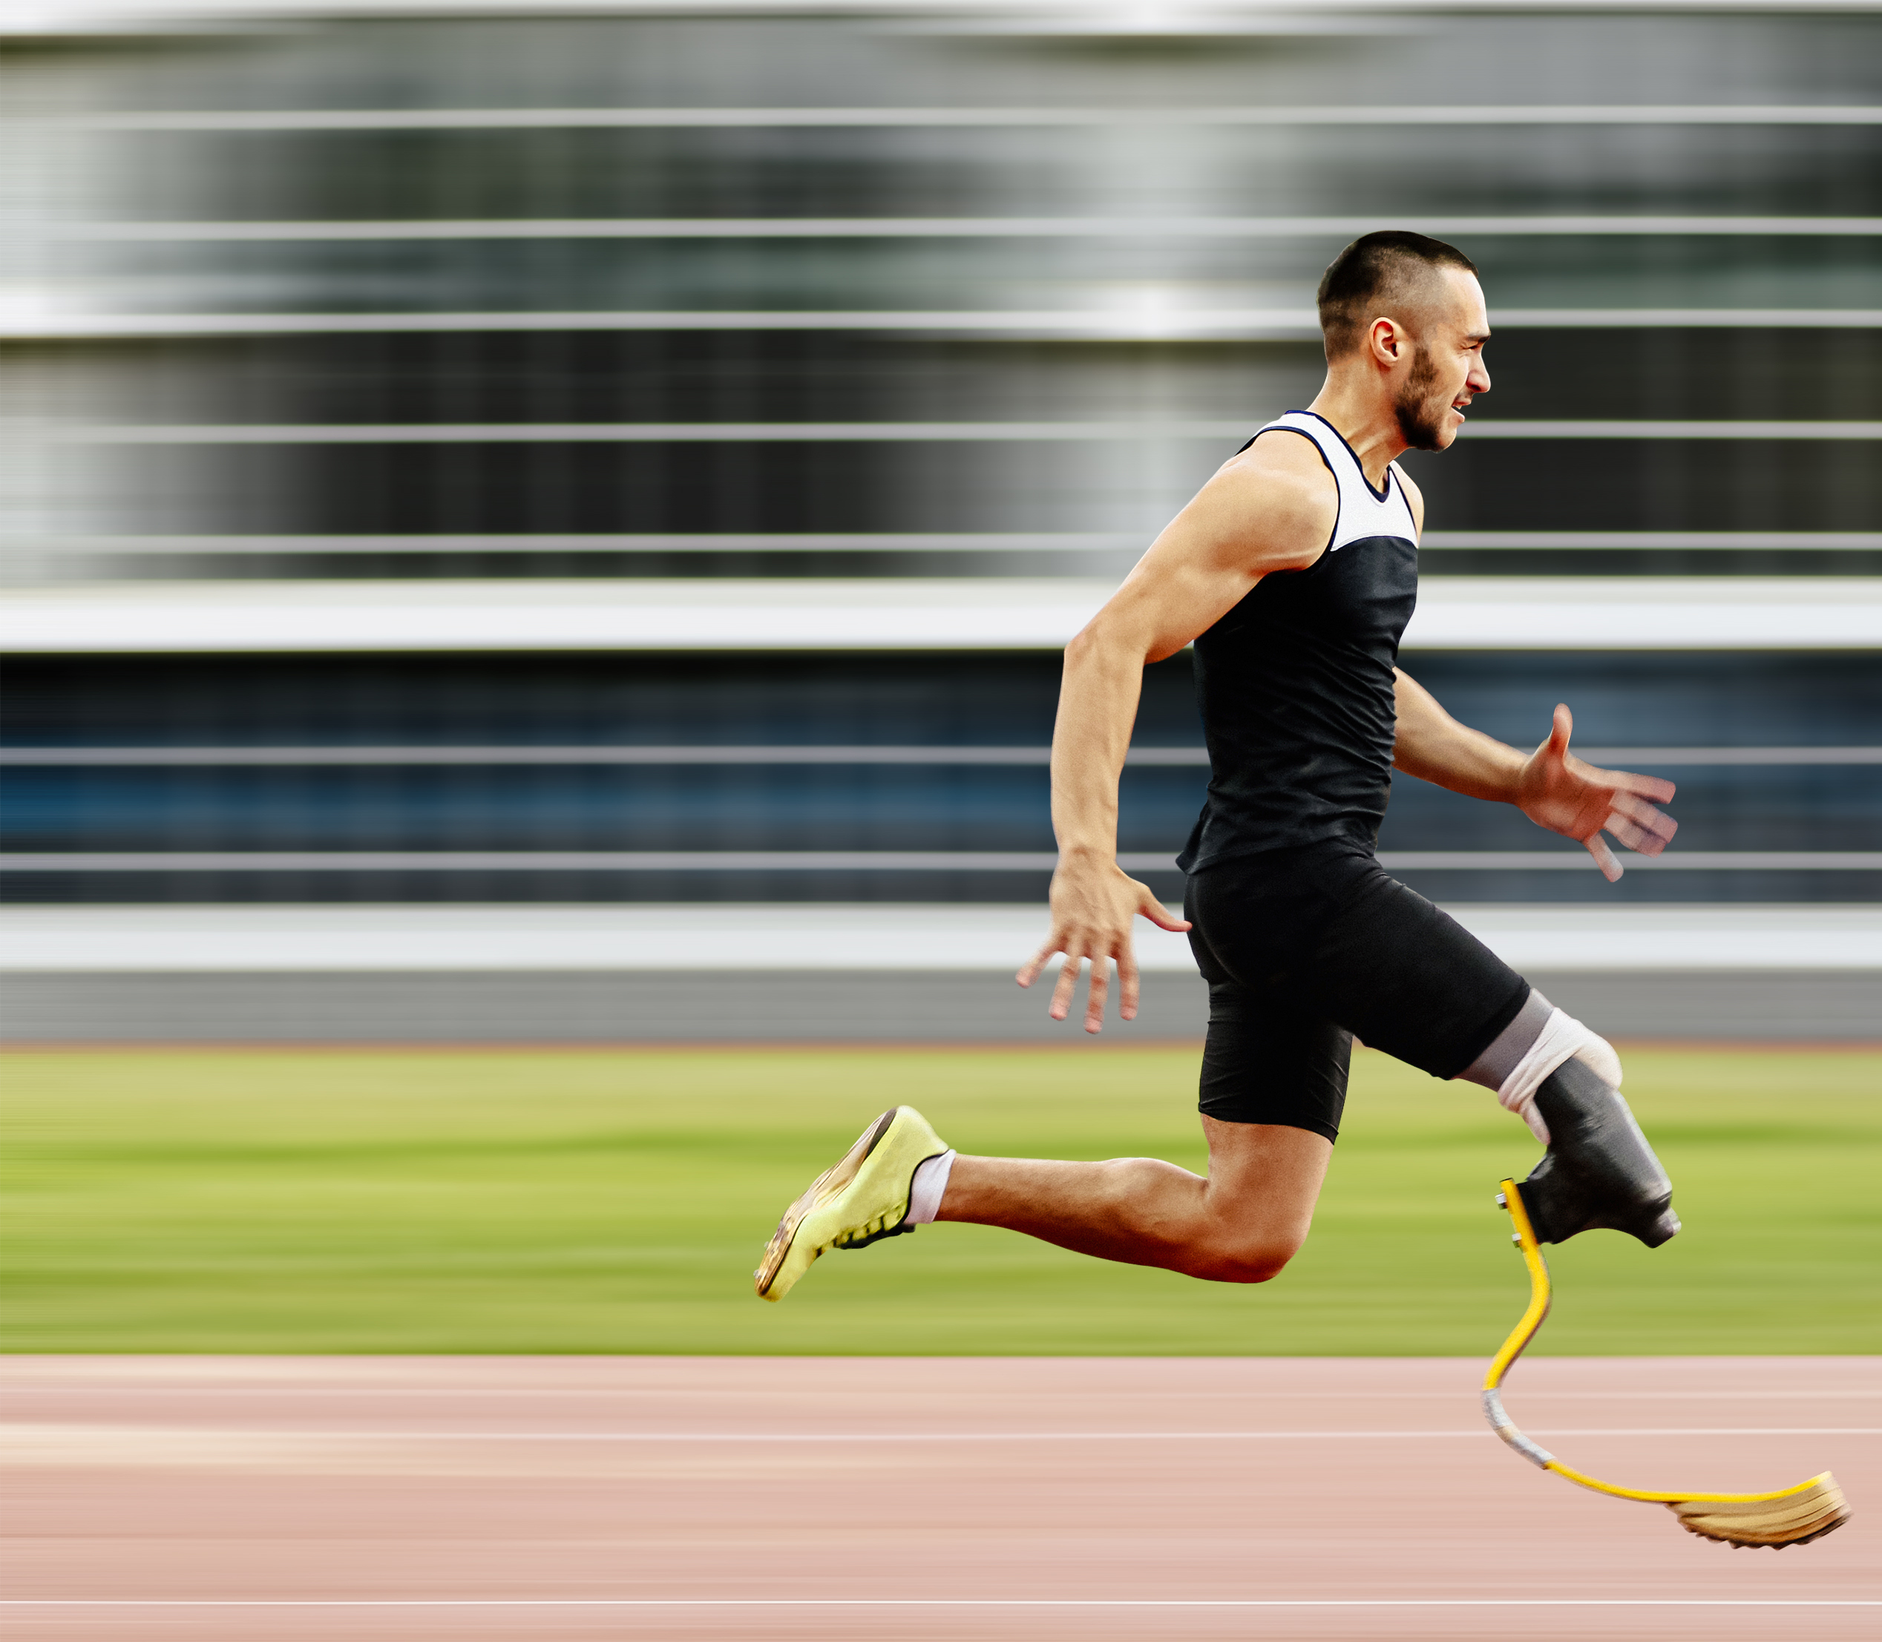
Practical Applications
13
Personalized Training Programs:
Development: Based on fitness test data, targeting specific improvement areas.
Optimization: Ensures athletes train at appropriate intensities and volumes.
Performance Optimization:
Monitoring: Regular fitness testing helps track progress and adjust training plans.
Load Management: Crucial for managing in-season training loads and avoiding overtraining. ^{508,509}
Recovery Strategies:
Design: Based on test results, ensuring effective recovery and injury prevention.
Implementation: Includes hydration, nutrition, rest, and active recovery techniques.
Return to Play Protocols:
Design: Fitness tests guide the development of protocols for safe and effective rehabilitation post-injury.
Evaluation: Ensures athletes are physically ready to return to competition.

Slide 14
Tests of main relevance for intermittent exercise capacity
Sub-categories | Generic examples and typical tests | Main physiological systems challenged | Relevance for intermittent sports
Maximum aerobic fitness Incremental lab or field-based assessments | Maximal oxygen uptake tests (433). Universiteté de Montréal track test (394). Vam Eval test (400) Maximal multistage 20-m shuttle run test (393). The multistage fitness test (392). | Aerobic power and movement economy during incremental exercise. (393) | - Non-specific exercise mode and pattern. - No-moderate associations to game performance (166, 385, 386). - Low sensitivity to detect differences between competitive levels and training-induced changes (167).
Threshold/critical power tests Continuous lab or field-based assessments. | Cooper running test (434). Critical power tests (170). Gas exchange/lactate threshold tests (435) ~1-3 km running tests (398). | Aerobic power, lactate threshold and movement economy during continuous/incremental/shuttle running. (55, 364) | - Non-specific exercise pattern. - Low-moderate associations game performance (398, 399). - Conflicting ability to distinguish competitive levels and smaller training-induced improvements (350, 401).
Intermittent shuttle running tests Fixed bout distance/duration at increasing speed. | Yo-Yo IR1 and IR2 (167). Yo-Yo IE1 and IE2 (173). 30-15 intermittent fitness test (403). Interval shuttle run test (402). | Aerobic power with a substantial anaerobic contribution to the energy yield with an emphasis on the ability to recover between repeated bouts and integration of running economy with turns and acceleration/deceleration phases. (165, 166, 173) | - Specific exercise mode and pattern. - Moderate-to-large associations to game performance (165, 166) . - High ability to distinguish between competitive levels and detect training-induced improvements (167).
Sport-specific intermittent endurance tests Developed for a specific sport incorporating the unique movement pattern. | The badminton-specific endurance test (424). The team handball game-based performance test (426). The squash specific fitness test (436). | Similar to intermittent shuttle running tests dependent on the specific test construct and with an emphasis on the sport-specific movement proficiency. | - Specific exercise mode and pattern. - Ability to distinguish between levels of play (424). - Reliability dependent on the specific test construct (ranging from low to high).
Recommendations:
14
Integration:
Fitness Testing and Match Analysis: Combine results for a holistic view of an athlete’s capabilities.
Comprehensive Test Battery: Include tests covering all aspects of physical fitness for a complete profile.
Relevance:
Testing Protocols: Ensure they are relevant to the sport and not overly taxing.
Frequency: Regular updates and adaptations based on the latest research and best practices.
Balance:
Testing and Training: Maintain a balance to prevent overburdening athletes and ensure effective training.
Customization: Tailor testing and training programs to individual athlete needs for optimal results.

Slide 15
Summary and Conclusions
15
Understanding Demands: Crucial for optimizing performance and preventing injuries in intermittent sports.
Role of Fitness Testing: Provides essential data for athlete development, training adjustments, and performance monitoring.
Continuous Evaluation: Necessary for sustained success, integrating testing with real-time performance analysis.
Individualized Training: Emphasize personalized training programs and recovery strategies tailored to each athlete’s unique needs and capabilities.
Future Directions: Encourage ongoing research and innovation in fitness testing and training methodologies to enhance athletic performance.

Slide 16
Acknowledgements
This slide deck was prepared by the ACSM Evidence-Based Practice Committee in collaboration with the authors.
Peter T. Katzmarzyk, Ph.D., FACSM
James Patrick MacDonald, M.D., M.P.H. FACSM
Christan E. Behrens, Jr., PhD
Hayley V. MacDonald, Ph.D.
Christina Anne Day
Dawn Podulka Coe, Ph.D., FACSM
Mary P. Miles, Ph.D., FACSM
Terry L. Nicola, M.D., FACSM
Bridget A. Peters, DO, PhD
Adrienne Wald, EdD
Melicia C. Whitt-Glover, Ph.D., FACSM
John Willson
Laura Young, PhD

Slide 17
References
1. Wing C, Hart NH, Ma'ayah F, Nosaka K. Evaluating match running performance in elite Australian football: a narrative review. BMC Sports Sci Med Rehabil. 2021;13(1):136.
2. Stojanovic E, Stojiljkovic N, Scanlan AT, Dalbo VJ, Berkelmans DM, Milanovic Z. The activity demands and physiological responses encountered during basketball match-play: a systematic review. Sports Med. 2018;48(1):111–35.
3. Johnston RD, Black GM, Harrison PW, Murray NB, Austin DJ. Applied sport science of Australian football: a systematic review. Sports Med. 2018;48(7):1673–94.
4. Phomsoupha M, Laffaye G. The science of badminton: game characteristics, anthropometry, physiology, visual fitness and biomechanics. Sports Med. 2015;45(4):473–95.
5. Bradley PS, Carling C, Gomez Diaz A, et al. Match performance and physical capacity of players in the top three competitive standards of English professional soccer. Hum Mov Sci. 2013;32(4):808–21
6. Michalsik LB, Aagaard P, Madsen K. Locomotion characteristics and match-induced impairments in physical performance in male elite team handball players. Int J Sports Med. 2013;34(7):590–9.
8. Harper DJ, Carling C, Kiely J. High-intensity acceleration and deceleration demands in elite team sports competitive match play: a
systematic review and meta-analysis of observational studies. Sports Med. 2019;49(12):1923–47
9. Spencer M, Bishop D, Dawson B, Goodman C. Physiological and metabolic responses of repeated-sprint activities:specific to field based team sports. Sports Med. 2005;35(12):1025–44.
10. Ju W, Doran D, Hawkins R, et al. Contextualised peak periods of play in English premier league matches. Biol Sport. 2022;39(4):973–83.
Vigh-Larsen JF, Mohr M. The physiology of ice hockey performance: an update. Scand J Med Sci Sports. 2024;34(1):e14284.
Morrison M, Martin DT, Talpey S, et al. A systematic review on fitness testing in adult male basketball players: tests adopted, characteristics reported and recommendations for
practice. Sports Med. 2022;52(7):1491–532.
13. Haycraft JAZ, Kovalchik S, Pyne DB, Robertson S. Physical characteristics of players within the Australian football league participation pathways: a systematic review. Sports Med Open. 2017;3(1):46.
14. Mohr M, Krustrup P, Bangsbo J. Fatigue in soccer: a brief review. J Sports Sci. 2005;23(6):593–9.
26. Black GM, Gabbett TJ, Naughton GA, McLean BD. The effect of intense exercise periods on physical and technical performance during elite Australian football match-play: a comparison of experienced and less experienced players. J Sci Med Sport. 2016;19(7): 596–602.
29. Faude O, Meyer T, Rosenberger F, Fries M, Huber G, Kindermann W. Physiological characteristics of badminton match play. Eur J Appl Physiol. 2007;100(4):479–85
40. Liveris NI, Tsarbou C, Tsimeas PD, Papageorgiou G, Xergia SA, Tsiokanos A. Evaluating the effects of match-induced fatigue on landing ability; the case of the basketball game. Int J Exerc Sci. 2021;14(6):768–78
50. Thorsteinsson H, Vigh-Larsen JF, Panduro J, et al. The recovery of muscle function and glycogen levels following game-play in young elite male ice hockey players. Scand J Med Sci Sports. 2023;33(12): 2457–69.
52. Vigh-Larsen JF, Haverinen MT, Knudsen CB, et al. The relationship between age and fitness profiles in elite male ice hockey players. J Sports Med Phys Fitness. 2021;61(4):512–8
53. Vigh-Larsen JF, Haverinen MT, Panduro J, et al. On-ice and off-ice fitness profiles of elite and U20 male ice hockey players of two different national standards. J Strength Cond Res. 2020;34(12):
3369–76.

Slide 18
References
54. Vigh-Larsen JF, Beck JH, Daasbjerg A, et al. Fitness characteristics of elite and subelite male ice hockey players: a cross-sectional study. J Strength Cond Res. 2019;33(9):2352–60.
55. Vescovi JD, Murray TM, Vanheest JL. Positional performance profiling of elite ice hockey players. Int J Sports Physiol Perform. 2006;1(2):84–94.
67. Bangsbo J, Mohr M, Krustrup P. Physical and metabolic demands of training and match-play in the elite football player. J Sports Sci. 2006;24(7):665–74.
72. Krustrup P, Mohr M, Steensberg A, Bencke J, Kjaer M, Bangsbo j.. Muscle and blood metabolites during a soccer game: implications for sprint performance. Med Sci Sports Exerc. 2006;38(6): 1165–74.
74. Svensson M, Drust B. Testing soccer players. J Sports Sci. 2005; 23(6):601–181
78. match-related fatigue: a systematic review and meta-analysis. Sports Med. 2018;48(3):539–83.
79. Rampinini E, Bosio A, Ferraresi I, Petruolo A, Morelli A, Sassi A. Match-related fatigue in soccer players. Med Sci Sports Exerc. 2011;43(11):2161–70.
80. Michalsik LB, Aagaard P. Physical demands in elite team handball: comparisons between male and female players. J Sports Med Phys Fitness. 2015;55(9):878–91.
81. Karcher C, Buchheit M. On-court demands of elite handball, with special reference to playing positions. Sports Med. 2014;44(6): 797–814
85. Kovacs MS. Applied physiology of tennis performance. Br J Sports Med. 2006;40(5):381–5 discussion 6.
96. Kirkendall DT, Krustrup P. Studying professional and recreational female footballers: a bibliometric exercise. Scand J Med Sci Sports. 2022;32(1 Suppl):12–26.
97. Douglas J, Ross A, Martin JC. Maximal muscular power: lessons from sprint cycling. Sports Med Open. 2021;7(1):48.
98. Morin JB, Bourdin M, Edouard P, Peyrot N, Samozino P, Lacour JR. Mechanical determinants of 100-m sprint running performance. Eur J Appl Physiol. 2012;112(11):3921–30
99. Haugen T, Seiler S, Sandbakk O, Tonnessen E. The training and development of elite sprint performance: an integration of scientific and best practice literature. Sports Med Open. 2019;5(1):44.
100. Harper DJ, McBurnie AJ, Santos TD, et al. Biomechanical and neuromuscular performance requirements of horizontal deceleration: a review with implications for random intermittent multi-directional sports. Sports Med. 2022;52(10):2321–54.
101. Allen DG, Lamb GD, Westerblad H. Skeletal muscle fatigue: cellular mechanisms. Physiol Rev. 2008;88(1):287–332.
102. Hostrup M, Bangsbo J. Limitations in intense exercise performance of athletes—effect of speed endurance training on ion handling and fatigue development. J Physiol. 2017;595(9):2897–913.
103. Bishop DJ. Fatigue during intermittent-sprint exercise. Clin Exp Pharmacol Physiol. 2012;39(9):836–41.
104. Girard O, Mendez-Villanueva A, Bishop D. Repeated-sprint ability part I: factors contributing to fatigue. Sports Med. 2011;41(8): 673–94.
105. Glaister M. Multiple sprint work: physiological responses, mechanisms of fatigue and the influence of aerobic fitness. Sports Med. 2005;35(9):757–77
106. Hostrup M, Bangsbo J. Performance adaptations to intensified training in top-level football. Sports Med. 2023;53(3):577–94
107. Gaitanos GC, Williams C, Boobis LH, Brooks S. Human muscle metabolism during intermittent maximal exercise. J Appl Physiol (1985). 1993;75(2):712–9.
108. Glaister M, Stone MH, Stewart AM, Hughes M, Moir GL. The influence of recovery duration on multiple sprint cycling performance. J Strength Cond Res. 2005;19(4):831–7.
109. Bogdanis GC, Nevill ME, Lakomy HK, Boobis LH. Power output and muscle metabolism during and following recovery from 10 and 20 s of maximal sprint exercise in humans. Acta Physiol Scand. 1998;163(3):261–72.
110. Bogdanis GC, Nevill ME, Lakomy HK, Graham CM, Louis G. Effects of active recovery on power output during repeated maximal sprint cycling. Eur J Appl Physiol Occup Physiol. 1996;74(5):461–9.

Slide 19
References
111. Bogdanis GC, Nevill ME, Boobis LH, Lakomy HK, Nevill AM. Recovery of power output and muscle metabolites following 30 s of maximal sprint cycling in man. J Physiol. 1995;482(Pt 2):467–80.
112. Balsom PD, Seger JY, Sjodin B, Ekblom B. Maximal-intensity intermittent exercise: effect of recovery duration. Int J Sports Med. 1992;13(7):528–33.
113. Vigh-Larsen JF, Ortenblad N, Andersen OE, et al. Fibre type and localisation-specific muscle glycogen utilisation during repeated high-intensity intermittent exercise. J Physiol. 2022;600(21): 4713–30.
114. Mohr M, Nordsborg N, Nielsen JJ, et al. Potassium kinetics in human muscle interstitium during repeated intense exercise in relation to fatigue. Pflugers Arch. 2004;448(4):452–6.
115. Gunnarsson TP, Christensen PM, Thomassen M, Nielsen LR, Bangsbo J. Effect of intensified training on muscle ion kinetics, fatigue development, and repeated short-term performance in endurance-trained cyclists. Am J Physiol Regul Integr Comp Physiol. 2013;305(7):R811–21.
116. Vigh-Larsen JF, Ortenblad N, Nielsen J, Andersen OE, Overgaard K, Mohr M. The role of muscle glycogen content and localization in high-intensity exercise performance: a placebo-controlled trial. Med Sci Sports Exerc. 2022;54(12):2073–86.
117. Doeven SH, Brink MS, Kosse SJ, Lemmink K. Postmatch recovery of physical performance and biochemical markers in team ball sports: a systematic review. BMJ Open Sport Exerc Med. 2018; 4(1):e000264.
118. Nedelec M, McCall A, Carling C, Legall F, Berthoin S, Dupont G. Recovery in soccer: part I—post-match fatigue and time course of recovery. Sports Med. 2012;42(12):997–1015.
119. Jones AM. The fourth dimension: physiological resilience as an independent determinant of endurance exercise performance. J Physiol. 2023. doi: 10.1113/JP284205.
124. Spragg J, Leo P, Swart J. The relationship between physiological characteristics and durability in male professional cyclists. Med Sci Sports Exerc. 2023;55(1):133–40.
121. Maunder E, Seiler S, Mildenhall MJ, Kilding AE, Plews DJ. The importance of 'durability' in the physiological profiling of endurance athletes. Sports Med. 2021;51(8):1619–28.
122. Clark I, Vanhatalo A, Thompson C, et al. Changes in the power duration relationship following prolonged exercise: estimation using conventional and all-out protocols and relationship to muscle glycogen. Am J Physiol Regul Integr Comp Physiol. 2019;317(1):R59–67.
123. Clark IE, Vanhatalo A, Thompson C, et al. Dynamics of the power duration relationship during prolonged endurance exercise and influence of carbohydrate ingestion. J Appl Physiol (1985). 2019; 127(3):726–36.
124. Clark IE, Vanhatalo A, Bailey SJ, et al. Effects of two hours of heavy-intensity exercise on the power–duration relationship. Med
Sci Sports Exerc. 2018;50(8):1658–68
125. Hargreaves M, Spriet LL. Skeletal muscle energy metabolism during exercise. Nat Metab. 2020;2(9):817–28.
126. Gastin PB. Energy system interaction and relative contribution during maximal exercise. Sports Med. 2001;31(10):725–41
127. Sahlin K. Muscle energetics during explosive activities and potential effects of nutrition and training. Sports Med. 2014;44(2 Suppl): S167–73.
128. Serresse O, Lortie G, Bouchard C, Boulay MR. Estimation of the contribution of the various energy systems during maximal work of short duration. Int J Sports Med. 1988;9(6):456–60.
130. Spriet LL. Anaerobic metabolism in human skeletal muscle during shortterm, intense activity. Can J Physiol Pharmacol. 1992;70(1):157–65.
133. Krustrup P, Gonzalez-Alonso J, Quistorff B, Bangsbo J. Muscle heat production and anaerobic energy turnover during repeated intense dynamic exercise in humans. J Physiol. 2001;536(Pt 3): 947–56.

Slide 20
References
138. Pyne DB, Gardner AS, Sheehan K, Hopkins WG. Positional differences in fitness and anthropometric characteristics in Australian football. J Sci Med Sport. 2006;9(1–2):143–50.
139. Jennings J, Staka Z, Wundersitz DW, et al. Position-specific running and technical demands during male elite-junior and elite senior Australian rules football match-play. J Strength Cond Res. 2023;37(7):1449–55.
140. Fleureau A, Rabita G, Leduc C, Buchheit M, Lacome M. Peak locomotor intensity in elite handball players: a first insight into player position differences and training practices. J Strength Cond Res. 2023;37(2):432–8
141. Panduro J, Ermidis G, Roddik L, et al. Physical performance and loading for six playing positions in elite female football: full-game, end-game, and peak periods. Scand J Med Sci Sports. 2022; 32(1 Suppl):115–26.
142. Peek RJ, Fleming JA, Carey DL, Middleton KJ, Gastin PB, Clarke AC. The temporal distribution and occurrence of impacts and movement relative to peak periods in men's rugby union. J Sci Med Sport. 2022;25(9):776–82.
143. Couderc A, Lacome M, Cheradame J, Carling C, Piscione J. Peak running demands in elite women's rugby sevens and rugby union match play: a comparative study. Int J Sports Physiol Perform. 2023;18(9):1004–11.
144. Carling C, Le Gall F, Dupont G. Analysis of repeated high-intensity running performance in professional soccer. J Sports Sci. 2012; 30(4):325–36.
145. Carling C, McCall A, Harper D, Bradley PS. Comment on: "the use of microtechnology to quantify the peak match demands of the football codes: a systematic review". Sports Med. 2019;49(2):343–5
146. Luteberget LS, Gilgien M. Validation methods for global and local positioning-based athlete monitoring systems in team sports: a scoping review. BMJ Open Sport Exerc Med. 2020;6(1):e000794.
159. Weldon A, Duncan MJ, Turner A, et al. Contemporary practices of strength and conditioning coaches in professional soccer. Biol Sport. 2021;38(3):377–90.
160. Ebben WP, Carroll RM, Simenz CJ. Strength and conditioning practices of National Hockey League strength and conditioning coaches. J Strength Cond Res. 2004;18(4):889–97.
161. Ebben WP, Blackard DO. Strength and conditioning practices of National Football League strength and conditioning coaches. J Strength Cond Res. 2001;15(1):48–58
162. Silva JR, Buchheit M, Hader K, Sarmento H, Afonso J. Building bridges instead of putting up walls: connecting the “teams” to improve soccer players' support. Sports Med. 2023;53(12):2309–20.
164. Krustrup P, Mohr M, Nybo L, Jensen JM, Nielsen JJ, Bangsbo J. The Yo-Yo IR2 test: physiological response, reliability, and application to elite soccer. Med Sci Sports Exerc. 2006;38(9):1666–73.
165. Krustrup P, Mohr M, Amstrup T, et al. The yo-yo intermittent recovery test: physiological response, reliability, and validity. Med Sci Sports Exerc. 2003;35(4):697–705.
166. Bangsbo J, Iaia FM, Krustrup P. The Yo-Yo intermittent recovery test: a useful tool for evaluation of physical performance in intermittent sports. Sports Med. 2008;38(1):37–51.
167. Silva JR. The soccer season: performance variations and evolutionary trends. PeerJ. 2022;10:e14082.
169. Jones AM, Vanhatalo A. The 'critical power' concept: applications to sports performance with a focus on intermittent high-intensity exercise. Sports Med. 2017;47(1 Suppl):65–78.
170. Fernandez-Fernandez J, Ulbricht A, Ferrauti A. Fitness testing of tennis players: how valuable is it? Br J Sports Med. 2014;48(1Suppl):i22–31.
171. Mendez-Villanueva A, Buchheit M. Football-specific fitness testing: adding value or confirming the evidence? J Sports Sci. 2013;31(13):1503–8.
172. Krustrup P, Bradley PS, Christensen JF, et al. The Yo-Yo IE2 test: physiological response for untrained men versus trained soccer players. Med Sci Sports Exerc. 2015;47(1):100–8

Slide 21
References
173. Faude O, Koch T, Meyer T. Straight sprinting is the most frequent action in goal situations in professional football. J Sports Sci. 2012;30(7):625–31.
179. McMahon JJ, Lake JP, Ripley NJ, Comfort P. Vertical jump testing in rugby league: a rationale for calculating take-off momentum. J Appl Biomech. 2020;36(6):370–4.
180. Samozino P, Edouard P, Sangnier S, Brughelli M, Gimenez P, Morin JB. Force–velocity profile: imbalance determination and effect on lower limb ballistic performance. Int J Sports Med. 2014;35(6):505–10.
187. Morral-Yepes M, Moras G, Bishop C, Gonzalo-Skok O. Assessing the reliability and validity of agility testing in team sports: a systematic review. J Strength Cond Res. 2022;36(7):2035–49.
212. Stojanovic E, Aksovic N, Stojiljkovic N, Stankovic R, Scanlan AT, Milanovic Z. Reliability, usefulness, and factorial validity of change-of-direction speed tests in adolescent basketball players. J Strength Cond Res. 2019;33(11):3162–73.
227. Cigni P, Minuti T, Mannini A, et al. Application of a custom device to measure isometric knee strength: possible injury correlation in professional soccer (football) players. J Funct Morphol Kinesiol. 2023;8(4):141
259. Dawson B, Goodman C, Lawrence S, et al. Muscle phosphocreatine repletion following single and repeated short sprint efforts. Scand J Med Sci Sports. 1997;7(4):206–13
269. Sandford GN, Laursen PB, Buchheit M. Anaerobic speed/power reserve and sport performance: scientific basis, current applications and future directions. Sports Med. 2021;51(10):2017–28.
271. Glaister M, Stone MH, Stewart AM, Hughes MG, Moir GL. Aerobic and anaerobic correlates of multiple sprint cycling performance. J Strength Cond Res. 2006;20(4):792–8.
281. Hermassi S, Hoffmeyer B, Irlenbusch L, et al. Relationship between the handball-specific complex-test and intermittent field test performance in professional players. J Sports Med Phys Fitness. 2018; 58(1–2):8–16.
282. Noordhof DA, Skiba PF, de Koning JJ. Determining anaerobic capacity in sporting activities. Int J Sports Physiol Perform. 2013; 8(5):475–82.
283. Bangsbo J, Michalsik L, Petersen A. Accumulated O2 deficit during intense exercise and muscle characteristics of elite athletes. Int J Sports Med. 1993;14(4):207–13
289. Keir DA, Theriault F, Serresse O. Evaluation of the running-based an aerobic sprint test as a measure of repeated sprint ability in collegiate level soccer players. J Strength Cond Res. 2013;27(6):1671–8.
308. Delisle-Houde P, Chiarlitti NA, Reid RER, Andersen RE. Relationship between physiologic tests, body composition changes, and on ice playing time in Canadian collegiate hockey players. J Strength Cond Res. 2018;32(5):1297–302.
316. Taylor JM, Macpherson TW, Spears IR, Weston M. Repeated sprints: an independent not dependent variable. Int J Sports Physiol Perform. 2016;11(7):693–6
322. Bracko MR. On-ice performance characteristics of elite and non elite women's ice hockey players. J Strength Cond Res. 2001;15(1):42–7.
333. Buchheit M. Repeated-sprint performance in team sport players: associations with measures of aerobic fitness, metabolic control and locomotor function. Int J Sports Med. 2012;33(3):230–9.
326. Gabbett TJ, Stein JG, Kemp JG, Lorenzen C. Relationship between tests of physical qualities and physical match performance in elite rugby league players. J Strength Cond Res. 2013;27(6):1539–45.
346. Rampinini E, Sassi A, Morelli A, Mazzoni S, Fanchini M, Coutts AJ. Repeated-sprint ability in professional and amateur soccer players. Appl Physiol Nutr Metab. 2009;34(6):1048–54.
349. Le Rossignol P, Gabbett TJ, Comerford D, Stanton WR. Repeated sprint ability and team selection in Australian football league players. Int J Sports Physiol Perform. 2014;9(1):161–5.
350. Dellal A, Wong del P. Repeated sprint and change-of-direction abilities in soccer players: effects of age group. J Strength Cond Res.2013;27(9):2504–8.

Slide 22
References
352. Abrantes C, Macas V, Sampaio J. Variation in football players’ sprint test performance across different ages and levels of competition. J Sports Sci Med. 2004;3(YISI 1):44–9.
358. Joyner MJ, Coyle EF. Endurance exercise performance: the physiology of champions. J Physiol. 2008;586(1):35–44.
359. Jones AM, Kirby BS, Clark IE, et al. Physiological demands of running at 2-hour marathon race pace. J Appl Physiol (1985). 2021; 130(2):369–79.
360. Jones AM, Burnley M. Oxygen uptake kinetics: an underappreciated determinant of exercise performance. Int J Sports Physiol Perform. 2009;4(4):524–32.
364. Dupont G, McCall A, Prieur F, Millet GP, Berthoin S. Faster oxygen uptake kinetics during recovery is related to better repeated sprinting ability. Eur J Appl Physiol. 2010;110(3):627–34.
382. Bangsbo J, Lindquist F. Comparison of various exercise tests with endurance performance during soccer in professional players. Int J Sports Med. 1992;13(2):125–32.
386. Ramsbottom R, Brewer J, Williams C. A progressive shuttle run test to estimate maximal oxygen uptake. Br J Sports Med. 1988;22(4):141–4.
392. Ryan S, Coutts AJ, Hocking J, Dillon PA, Whitty A, Kempton T. Physical preparation factors that influence technical and physical match performance in professional Australian football. Int J Sports Physiol Perform. 2018;13(8):1021–7.
393. Piggott BG, McGuigan MR, Newton MJ. Relationship between physical capacity and match performance in semiprofessional Australian rules football. J Strength Cond Res. 2015;29(2):478–82.
398. Schmitz B, Pfeifer C, Kreitz K, Borowski M, Faldum A, Brand SM.The Yo-Yo intermittent tests: a systematic review and structured compendium of test results. Front Physiol. 2018;9:870.
401. Haydar B, Haddad HA, Ahmaidi S, Buchheit M. Assessing intereffort recovery and change of direction ability with the 30-15 intermittent fitness test. J Sports Sci Med. 2011;10(2):346–54.
403. Bradley PS, Mohr M, Bendiksen M, et al. Sub-maximal and maximal Yo-Yo intermittent endurance test level 2: heart rate response, reproducibility and application to elite soccer. Eur J Appl Physiol. 2011;111(6):969–78.
424. Schimpchen J, Correia PF, Meyer T. Minimally invasive ways to monitor changes in cardiocirculatory fitness in running-based sports: a systematic review. Int J Sports Med. 2023;44(2):95–107.
426. Bosquet L, Merkari S, Arvisais D, Aubert AE. Is heart rate a convenient tool to monitor over-reaching? A systematic review of the literature. Br J Sports Med. 2008;42(9):709–14
433.Young WB, Hepner J, Robbins DW. Movement demands in Australian rules football as indicators of muscle damage. J Strength Cond Res. 2012;26(2):492–6.
434. Takarada Y. Evaluation of muscle damage after a rugby match with special reference to tackle plays. Br J Sports Med. 2003;37(5): 416–9.
435. Vigh-Larsen JF, Ortenblad N, Spriet LL, Overgaard K, Mohr M. Muscle glycogen metabolism and high-intensity exercise performance: a narrative review. Sports Med. 2021;51(9):1855–74.
436. Krustrup P, Mohr M, Nybo L, et al. Muscle metabolism and impaired sprint performance in an elite women's football game. Scand J Med Sci Sports. 2022;32(1 Suppl):27–38.
508. Andrade R, Wik EH, Rebelo-Marques A, et al. Is the acute: chronic workload ratio (ACWR) associated with risk of time-loss injury in professional team sports? A systematic review of methodology, variables and injury risk in practical situations. Sports Med. 2020;50(9):1613–35.
509. Malone S, Roe M, Doran DA, Gabbett TJ, Collins KD. Protection against spikes in workload with aerobic fitness and playing experience: the role of the acute:chronic workload ratio on injury risk in elite Gaelic football. Int J Sports Physiol Perform. 2017;12(3):393–401.

