Slide 1

American College of Sports Medicine
Contemporary Issue:
Health and Safety
of Female Wrestlers
Special Communication for the American College of Sports Medicine

Slide 2
2
To make preliminary recommendations for a safe minimum percentage body fatness for female wrestlers as part of the minimal wrestling weight (MWW) determination.
To identify valid body fat testing methods and their limitations.
To identify potential health issues for female wrestlers regarding weight cycling.
To provide an agenda for future research considerations that will help address the significantly limited peer-reviewed data on these concerns in female wrestlers.
GOALS OF
THE SPECIAL COMMUNICATION

Slide 3
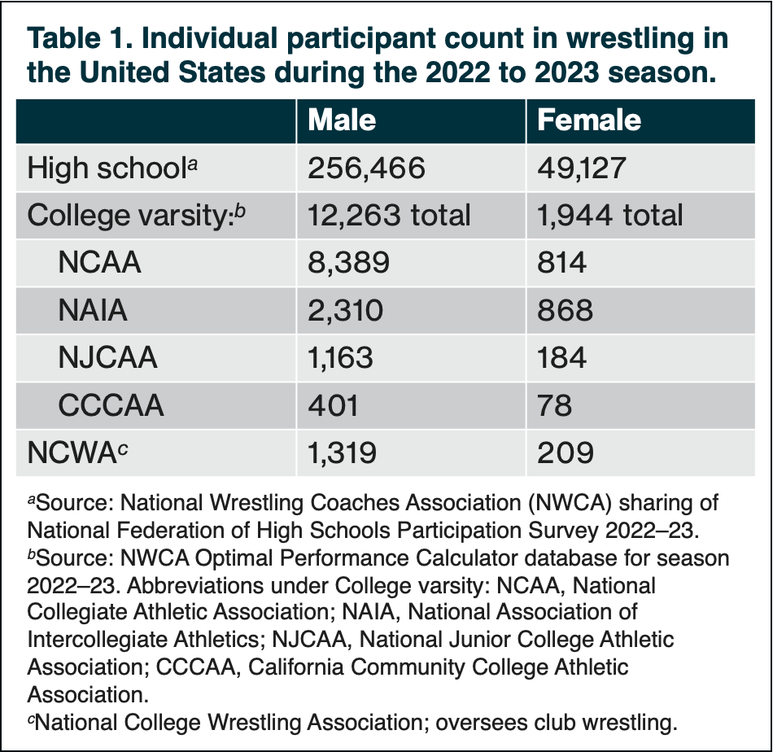
Introduction
3
The ACSM has a long-standing interest in the health and safety of wrestlers (1).
Wrestling was originally a male-only sport.
Female participation in the sport has grown exponentially over the past decade in the US:
  46 states recognize female high school wrestling
  153 colleges have programs
  It is on track to become an NCAA championship-level sport in 2026
A unique aspect of the sport is that weight classes are required for parity in size between the competitors.
Numerous health risks are associated with weight management strategies commonly used by male and female wrestlers to attain a competitive advantage
by competing in the lowest allowable weight class.

Slide 4

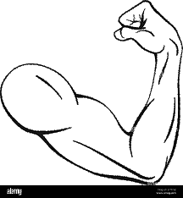
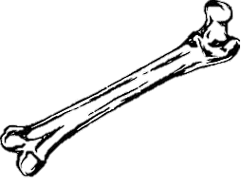
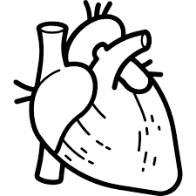
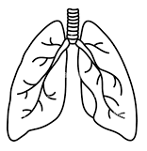
Health and Safety Concerns for Wrestlers (1)
Like other weight category sports, male and female wrestlers commonly use weight management strategies to attain a competitive advantage by competing in the lowest allowable weight class.
Weight loss is often accomplished by severe restriction of fluid and food intake, additional physical conditioning (beyond the normal training demands), and sometimes a combination of these behaviors.
Dehydration:
Exercising to induce sweat loss and restricting fluid intake are frequently combined to induce dehydration to make weight.
Passive dehydration such as sitting in a sauna or steam room also has been employed as well as using diuretics, laxatives, or forced vomiting.
Short-term dehydration of 2% to 3% of body weight reduction can be tolerated, but this requires rehydration between the weigh-in and prior to competition (2).
Passive dehydration and the use of medications are prohibited by SGBs (2).
>3% weight loss leaves wrestlers vulnerable to heat-stress injuries, particularly hyperthermia or exertional heat illness, which can have adverse and deadly consequences (2,4,5).
≥2% of body weight results in reduced plasma volume, impairs thermoregulation (2,6), and contributes to performance decrements.

Slide 5
Health and Safety Concerns for Wrestlers (2)
Low energy availability (LEA):
LEA is result of dietary energy restriction, increased exercise energy expenditure, or both.
LEA has multisystem health effects:
  Altered bone microarchitecture and diminished bone strength (8)
  Increased risk of bone stress injuries (9)
  Altered cardiovascular risk factors predisposing athletes to premature cardiac disease (10)
There is growing evidence to support these widespread health effects occur in male and female athletes when energy intake does not match total energy expenditure, termed relative energy deficiency in sports (REDs) (11)
Rapid weight loss (RWL):
Athletes in weight class sports are engaging in multiple short-term bouts of LEA and RWL to make weight for each competition (2).
Most of the weight lost in each RWL cycle can be rapidly gained back with increased water and food intake, therefore, these athletes are experiencing an accelerated version of what is termed weight cycling.
A recent consensus statement revealed that short-term, aggressive weight reduction adversely impacted health and performance in male and female athletes, whereas weight class athletes undergoing slow rates of weight loss (e.g., <0.8 kg·wk⁻¹) and at extended durations (>4 wk) were more likely to sustain health and performance (16).

Slide 6
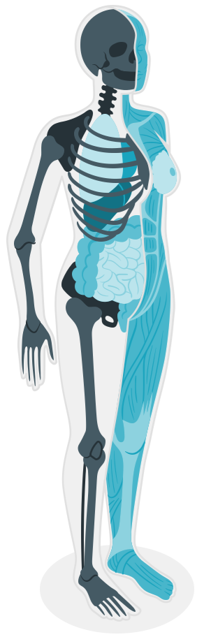
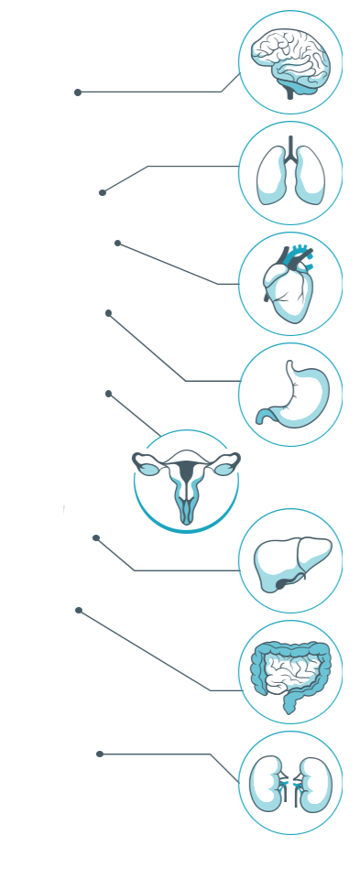
Unique Challenges for Female Wrestlers in the US: LEA, RWL, and low body fatness
6
Female wrestlers commonly train year-round and compete in 15 to 18 events over a 4-month competitive season.
These athletes use multiple, short periods of low energy availability (LEA) during the competitive season to achieve RWL (2).
LEA and low body fatness suppresses normal reproductive hormone cycling, causing menstrual dysfunction and loss of bone mineral density in girls and women.
This is combination of factors is commonly referred to as the female athlete triad (7).
Knowledge of the effects of multiple, short-term RWL bouts over a competitive season on reproductive hormones are lacking.
The optimal degree of body fatness for health and performance depends on many factors and has not been precisely determined, particularly for each sex.
Rapid weight loss (RWL) strategies, including intentional caloric restriction and decreased body fatness, are primary health and safety risks in this cohort.
As the number of female wrestlers grows, so does the need for increased research, education, and policy regarding these unique risks, including:
  Scheduling multiple competitions during the interscholastic and intercollegiate wrestling seasons;
  Regulation of minimal weight programs mandated by sport governing bodies (SGBs); and
  Female-specific health concerns including menstrual function and
  bone health.
Current regulations allow 12% minimum body fat for female wrestlers at the collegiate and high school level.

Slide 7
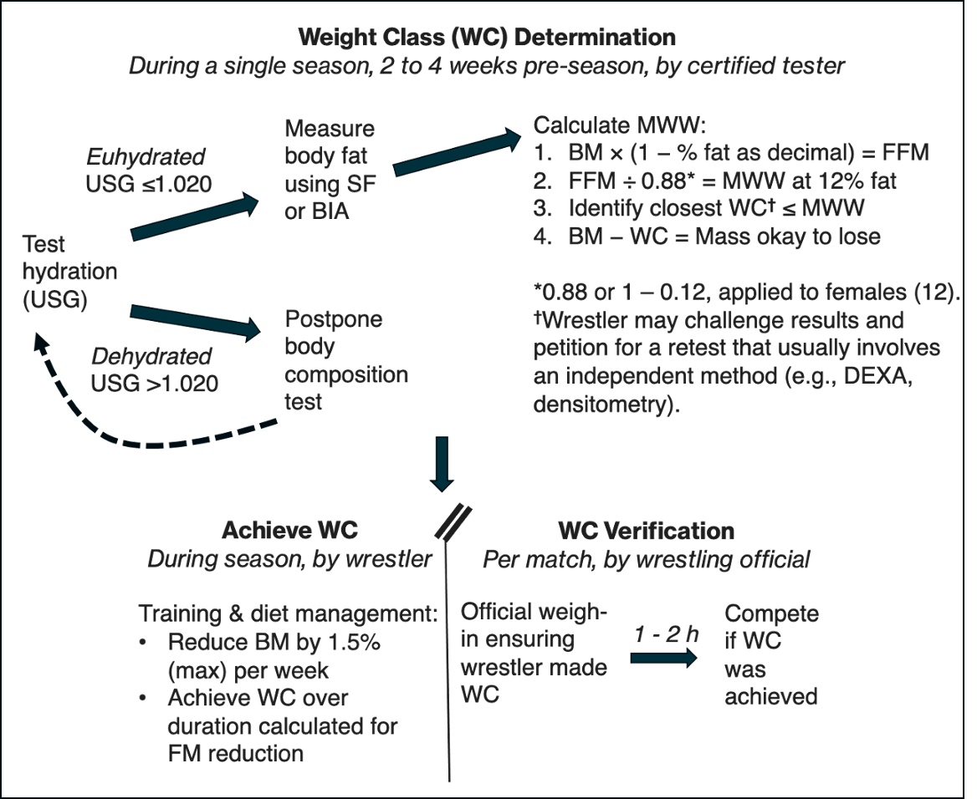
Current Protocol for Determining Minimal Wrestling Weight (MWW)
7
Prompted by health concerns (28) and several unfortunate deaths following extreme weight loss and dehydration (4), sport governing bodies (SGBs) mandated evidence-based methods to determine a wrestler's weight class.
The MWW is defined as the lowest attainable body mass that supports optimal health and performance, while controlling for body fatness.
Figure 1 depicts the current protocol and timeline for weight class determination using 12% body fat for the MWW in females, as specified prior to the development of interscholastic wrestling for females (12).
FIGURE 1. Protocol and timeline for making competitive wrestling weight.
WC: weight class established by sport-governing body; USG: urine specific gravity using refractometer; SF: skinfold method using SF calipers and population-specific equation; BIA: bioelectrical impedance assessed using impedance device; BM: current body
mass using a certified scale; FM: fat mass; MWW: minimal wrestling weight; DEXA:
dual energy X-ray absorptiometry; densitometry using underwater weighing or
air displacement plethysmography such as BodPod device.

Slide 8
The Rationale for 12% Minimal Body Fatness
Regular menstrual cycling and hormonal function have been observed in female athletes with <20% BF (31,33–36).
The inverse also is true: disruptions to reproductive hormone cyclic patterns (and other systemic effects) can occur in athletic women with >20% BF (37,38).
Therefore, deleterious health effects may occur from frequent weight cycling, energy restriction, and excessive activity, regardless of the degree of body fatness (11).
8
SGBs established 12% body fat (BF) as the minimum for determining MWW, presumably based on position stands from the ACSM, American Academy of Pediatrics, and National Athletic Trainers Association (12,29,30). However, the physiological basis for the 12% minimum is questionable.
ACSM’s original position on weight loss in wrestlers (12) cited McArdle et al. (31) who, in defining minimal weight in females, proposed 12% as the lowest essential fat percentage, i.e., the proportion of BF that provides indispensable needs for cell structures, hormones, intramuscular energy, and adipose tissue for insulation, energy reserves, and reproductive functions.
This review performed a systematic search to determine what %BF values are reported for female wrestlers at the high school, collegiate, and international levels of the sport.
Based on the 14 papers (326 female wrestlers), mean BF values ranged from 18% to 22%, with a weighted mean of 20.3% ± 4.2% (Table 2).
BF values, on average, rarely approached the 12% threshold, when it does, it may be exclusively in preadolescents (52).
1,172 records were identified
217 underwent full-text review
14 papers
(32 samples) were included

Slide 9
LIMITATIONS OF CURRENT
BODY FAT ASSESSMENT METHODS
Skinfold (SF) measures are the primary method used for MWW determination.
SFs can be used to test large groups of athletes in relatively short periods with affordable technology.
SF accuracy is highly variable with inexperienced assessors.
SGB-approved SF equation was developed using a multi-component criterion method and validated in Black and Caucasian nonathletes.
It has yet to be cross-validated for female wrestlers, particularly Hispanic and high school wrestlers.
At the collegiate level, different BF assessment modes have yielded differences in MWW of up to 3.3 kg (58).
The selection BF technique and/or prediction equations can have an outsized influence on the resulting MWW values.

Slide 10

Major Recommendations
Weight cycling and restrictive eating should be avoided as the health effects could be severe and long lasting. Likewise, intentional dehydration should be avoided or limited to no more than a 2% to 3% reduction in body weight.
These recommendations reflect the writing team’s expert opinion, based on the limited available data and our clinical evaluations of female wrestlers. These recommendations must be revisited as more data become available.
Female wrestlers often train year-round, as such, we recommend competing in a weight class closer to their natural body weight and that low %BF be deemphasized as a training goal, as others have recently recommended for preventing REDs (61).
1
We recommend female wrestlers compete at
a healthy weight that can be maintained with minimal weight cycling and that avoids menstrual cycle disruptions and minimizes the risk of broader health concerns.
Additional research and clinical evaluations on female wrestlers are needed. Existing studies are limited and modest in size, may include technical and biological errors in assessment, combine highly fit and pre- or off-season competitors, and make untested assumptions when compared to the studies on male counterparts.
1
For wrestling, healthy weight will be determined by establishing a %BF threshold that precludes extreme degrees of leanness and excessive weight loss. %BF thresholds for MWW determination may vary by athlete, but the 12% minimum is too low and should be revised upward to 18% to 20%.
If a female’s natural body fat is 12% or below a revised standard, they would be not disqualified from competing but would not be able to reduce to a lower weight class.

Slide 11
11
Specific Research Questions Proposed
by This Contemporary Issue

Slide 12
Acknowledgements
This slide deck was prepared by the ACSM Evidence-Based Practice Committee in collaboration with the authors.
Peter T. Katzmarzyk, Ph.D., FACSM
James Patrick MacDonald, M.D., M.P.H. FACSM
Christan E. Behrens, Jr., PhD
Hayley V. MacDonald, Ph.D.
Christina Anne Day
Dawn Podulka Coe, Ph.D., FACSM
Mary P. Miles, Ph.D., FACSM
Terry L. Nicola, M.D., FACSM
Bridget A. Peters, DO, PhD
Adrienne Wald, EdD
Melicia C. Whitt-Glover, Ph.D., FACSM
John Willson
Laura Young, PhD

Slide 13
References
1. American College of Sports Medicine. Position statement: weight loss in wrestlers. Med. Sci. Sports. 1976; 8:xi–xiii.
2. Burke LM, Diet GD, Slater GJ, et al. ACSM consensus statement on weight loss in weight-category sports. Curr. Sports Med. Rep. 2021; 20:199–217.
4. Centers for Disease Control and Prevention (CDC). Hyperthermia and dehydration-related deaths associated with intentional rapid weight loss in three collegiate wrestlers — North Carolina, Wisconsin, and Michigan, November–December 1997. MMWR Morb. Mortal. Wkly Rep. 1998; 47:105–8.
5. Casa DJ, DeMartini JK, Bergeron MF, et al. National Athletic Trainers' association position statement: exertional heat illnesses. J. Athl. Train. 2015; 50: 986–1000.
6. Racinais S, Alonso JM, Coutts AJ, et al. Consensus recommendations on training and competing in the heat. Br. J. Sports Med. 2015; 49:1164–73.
7. Nattiv A, Loucks AB, Manore MM, et al. American College of Sports Medicine position stand: the female athlete triad. Med. Sci. Sports Exerc. 2007; 39:1867–82.
8. Ackerman KE, Nazem T, Chapko D, et al. Bone microarchitecture is impaired in adolescent amenorrheic athletes compared with eumenorrheic athletes and nonathleteccontrols. J. Clin. Endocrinol. Metab. 2011; 96:123–3133.
9. Barrack MT, Gibbs JC, De Souza MJ, et al. Higher incidence of bone stress injuries with increasing female athlete triad-related risk factors. Am. J. Sports Med. 2014; 42:949–58.
10. Rickenlund A, Eriksson MJ, Schenck-Gustafsson K, et al. Amenorrhea in female athletes is associated with endothelial dysfunction and unfavorable lipid profile. J. Clin. Endocrinol. Metab. 2005; 90:1354–9.
11. Mountjoy M, Ackerman KE, Bailey DM, et al. 2023 International Olympic Committee's (IOC) consensus statement on relative energy deficiency in sport (REDs). Br. J. Sports Med. 2023; 57:1073–97.
12. Oppliger RA, Case HS, Horswill CA, et al. American College of Sports Medicine position stand. Weight loss in wrestlers. Med. Sci. Sports Exerc. 1996; 28:135–8.

Slide 14
References (2)
16. Mathisen TF, Ackland T, Burke LM, et al. Best practice recommendations for body composition considerations in sport to reduce health and performance risks: a critical review, original survey and expert opinion by a subgroup of the IOC consensus on relative energy deficiency in sport (REDs). Br. J. Sports Med. 2023; 57:1148–58.
28. Harms RL. Wisconsin wrestling minimum weight project. Wis. Med. J. 1992 Apr; 91:173–5.
29. Turocy PS, DePalma BF, Horswill CA, et al, National Athletic Trainers' association. National Athletic Trainers' association position statement: safe weight loss and maintenance practices in sport and exercise. J. Athl. Train. 2011; 46: 322–36.
30. Carl RL, Johnson MD, Martin TJ, Council on Sports Medicine and Fitness. Promotion of healthy weight- control practices in young athletes. Pediatrics. 2017; 140:e20171871.
31. McArdle WD, Katch FI, Katch VL. Exercise Physiology: Energy, Nutrition, and Human Performance. 3rd ed. Malvern (PA): Lea & Febiger; 1991. p. 488.
33. Katch FI, Spiak DL. Validity of the mellits and cheek method for body-fat estimation in relation to menstrual cycle status in athletes and non-athletes below 22 per cent fat. Ann. Hum. Biol. 1984; 11:389–96.
34. Estok PJ, Rudy EB, Just JA. Body-fat measurements and athletic menstrual irregularity. Health Care Women Int. 1991; 12:237–48.
35. Melin A, Tornberg ÅB, Skouby S, et al. Energy availability and the female athlete triad in elite endurance athletes. Scand. J. Med. Sci. Sports. 2015; 25:610–22.
36. Redman LM, Loucks AB. Menstrual disorders in athletes. Sports Med. 2005; 35:747–55.
37. VanHeest JL, Rodgers CD, Mahoney CE, De Souza MJ. Ovarian suppression impairs sport performance in junior elite female swimmers. Med. Sci. Sports Exerc. 2014; 46:156–66.
38. Singhal V, Reyes KC, Pfister B, et al. Bone accrual in oligo-amenorrheic athletes, eumenorrheic athletes and non-athletes. Bone. 2019; 120:305–13.
52. Arakawa H, Yamashita D, Arimitsu T, et al. Body composition and physical fitness profiles of elite female Japanese wrestlers aged <12 years until >20 years. Sports (Basel). 2020; 8:81.

Slide 15
References (3)
58. Cutrufello PT, Landram MJ, Venezia AC, Dixon CB. A comparison of methods used to determine percent body fat, minimum wrestling weight, and lowest allowable weight class. J. Strength Cond. Res. 2021; 35:633–7.
61. Hunter SK, S Angadi S, Bhargava A, et al. The biological basis of sex differences in athletic performance: consensus statement for the American College of Sports Medicine. Med. Sci. Sports Exerc. 2023; 55:2328–60.
*numbering from complete paper

